Slide 1
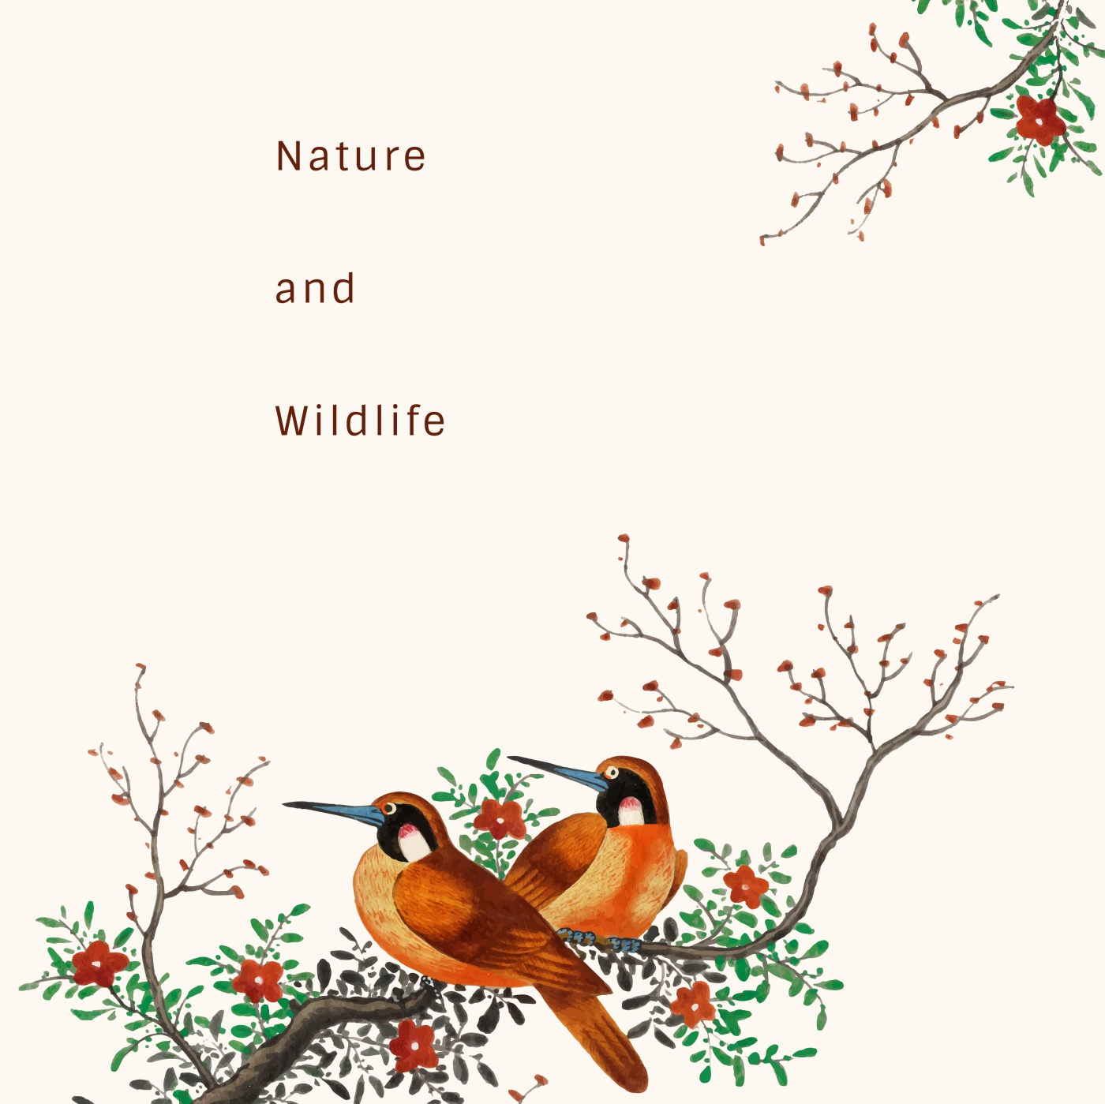


ggplot Wizardry My Favorite Tricks and Secrets for Beautiful Plots in R
Dr. Cédric Scherer Freelancing Data Visualization Designer
Image: Freepik.com
Notes:
Welcome, my name is Cédric Scherer.
First of all, I want to thank you for tuning in and the organizers of the Outlier Conference for putting together such a great and diverse event and for inviting me!
I am going to talk about ggplot2 which is a great and powerful system to create elegant graphics in a reproducible way and it is becoming a commonly used tool in the data visualization community. Its incredible flexibility allows you to draw almost every chart you wish for and one can literally modify every part of a plot – one just needs to know how.
(ALT+4)
In my talk I will showcase the versatility of ggplot2, provide an overview of interesting extensions, and will tell you a few tricks you may not know yet. I hope all or at least some of these will be helpful to take your ggplot design to the next level.

Slide 2

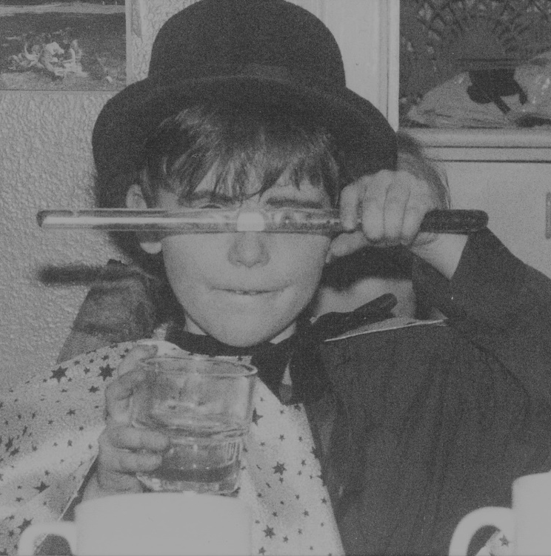
Scientist by Training
DataVizard by Heart
Computational Ecology at the Leibniz Institute for Zoo and Wildlife Research
Self-employed Data Visualization Designer & Workshop Instructor
Notes:
I am currently working as a PostDoc in computational ecology at the Leibniz Institute for Zoo and Wildlife Research in Berlin, Germany. For my projects, I mostly use the programing language R to analyse and visualize temporal and spatial data of animal populations, communities and diseases.
Over the last years I combined my scientific education and programing skills with my passion for design and my perfectionism to work as a self-employed data visualization designer and workshop instructor. For most of my visualizations, no matter if scientific papers, client requests, workshops, or personal projects I use ggplot2.

Slide 3
ggplot2
[ gee–gee–plot–two ]
an R package
is a system for declaratively creating graphics based on “The Grammar of Graphics”.
Notes:
ggplot2 defines itself as „a system for declaratively creating grpahics based on „The Grammar of Graphics““, which is a framework proposed by Leland Wilkinson.
ggplot2, which has been developed by Hadley Wickham, is a package that adds this functionaility of composing plots layer by layer to the R programing language.
Rather than being limited to a set of pre-defined chart types, you can create visualizations that are tailored to your specific use case.

Slide 4
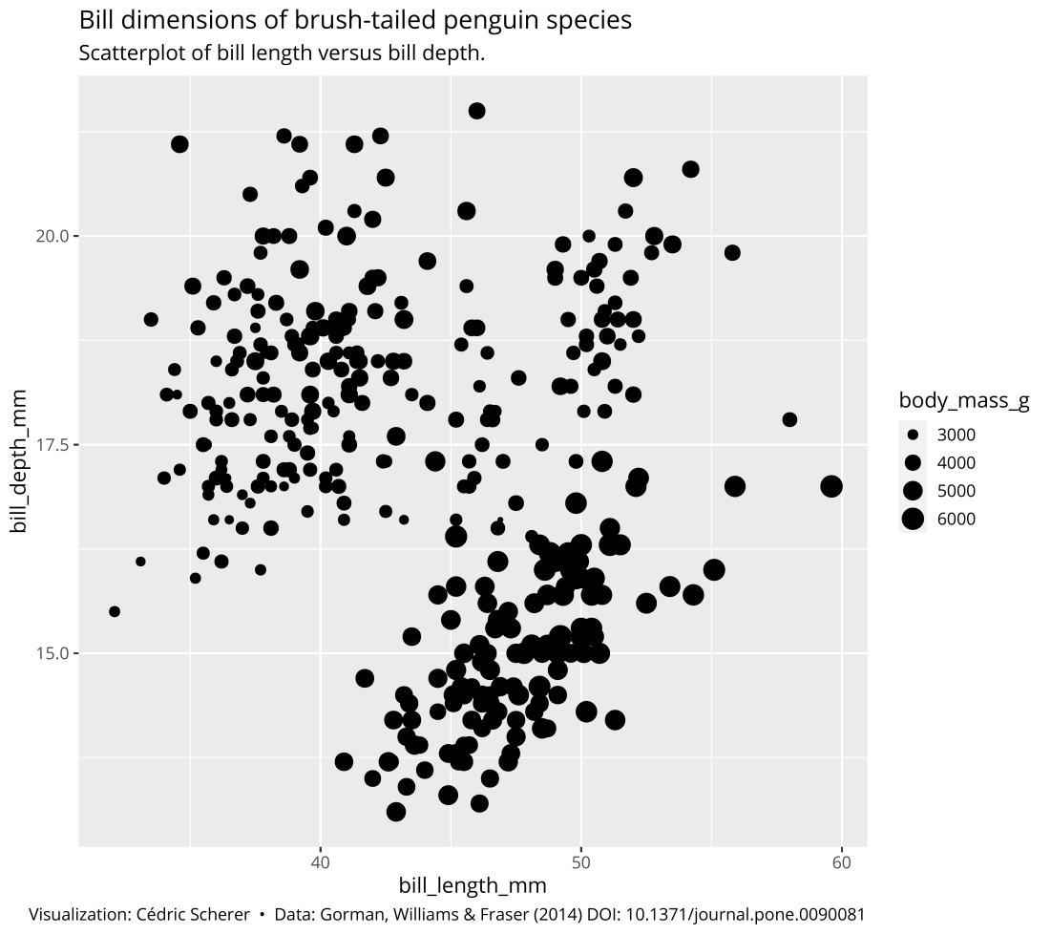
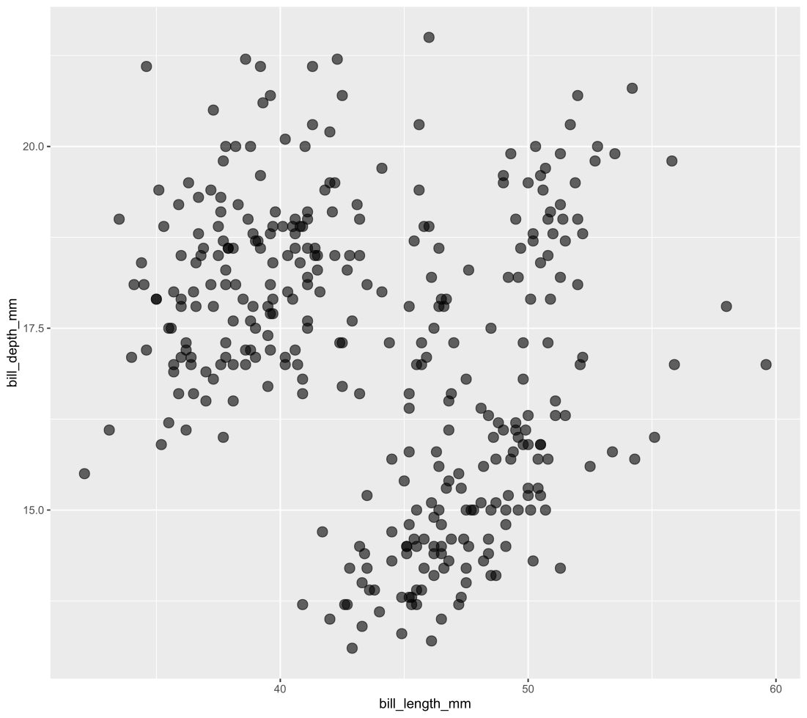

ggplot(data = penguins, aes(x = bill_length_mm, y = bill_depth_mm)) +
geom_point(alpha = .6)
You provide the data, tell ggplot2 how to map variables to aesthetics, what graphical primitives to use, and it takes care of the details.
Notes:
Basically, you provide the data and decide how to map variables to aesthetics and what graphical primitives to use and ggplot2 takes care of the details.
This scatterplot for example can be created with two lines of code — assuming that both the data and the package is loaded already — by specifying the variables mapped to x and y and the geometry one wants to plot.

Slide 5
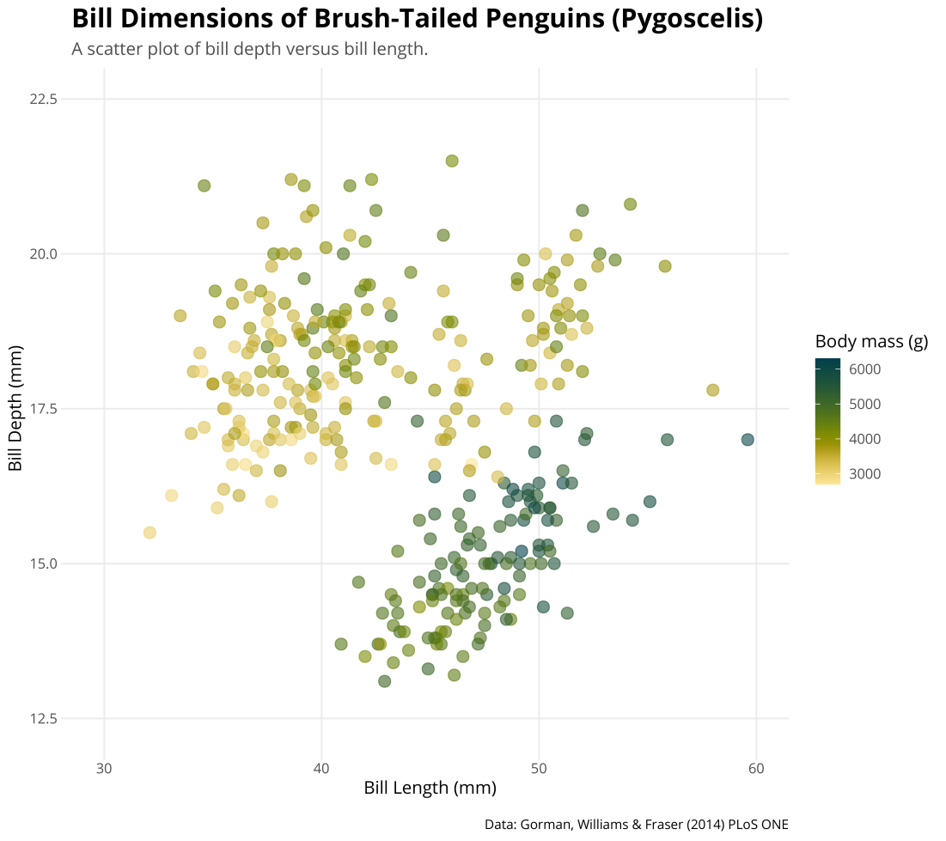
ggplot(data = penguins, aes(x = bill_length_mm, y = bill_depth_mm)) +
geom_point(alpha = .6)
You provide the data, tell ggplot2 how to map variables to aesthetics, what graphical primitives to use, and it takes care of the details.
Notes:
With a bit more code, we can add a third variable mapped to color and tune the default presets as one likes. Here I used a custom color palette, added proper titles and a caption, and changed the theme and scaling of the axes.

Slide 6
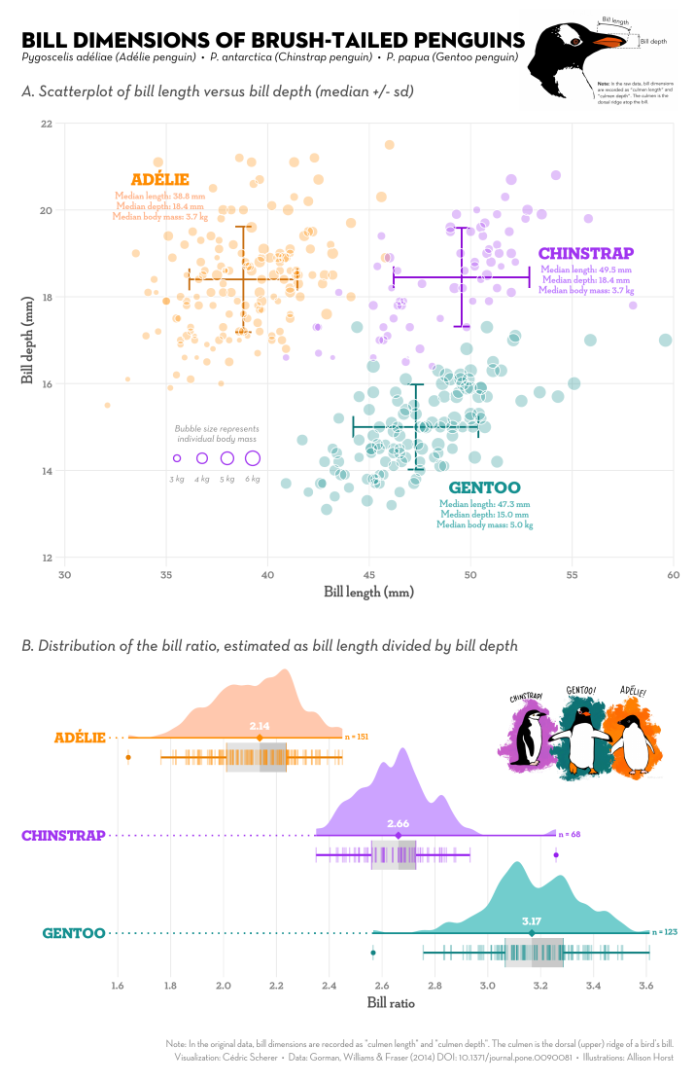
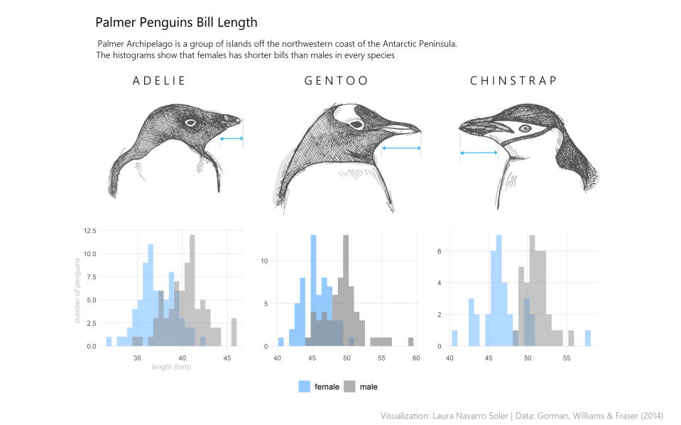
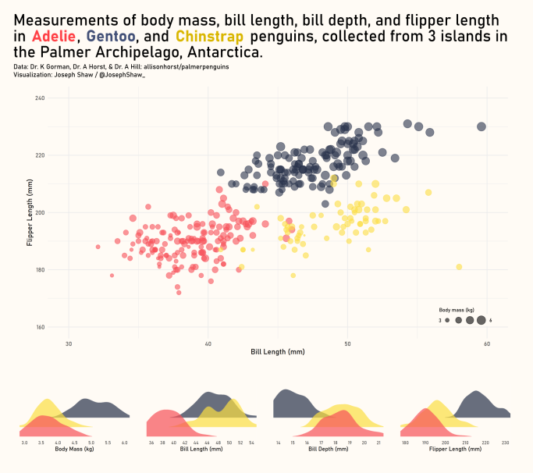

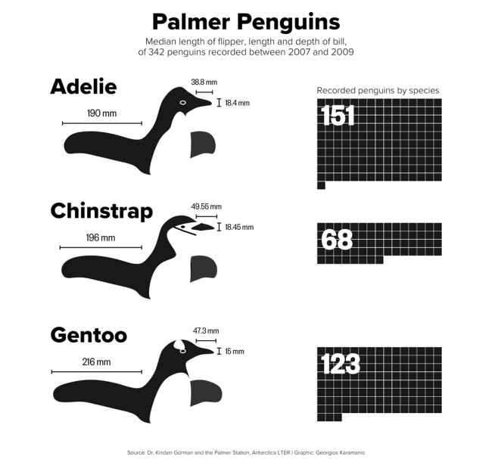
Color choice
Include images
#TidyTuesday Contributions by ← myself ↖ Laura Navarro ↙ Joe Shaw ↓ Georgios Karamanis
Annotations
Legend design
Text styling
Spacing
Combining geoms
Unusual geoms
Combining multiple plots
You provide the data, tell ggplot2 how to map variables to aesthetics, what graphical primitives to use, and it takes care of the details.
Notes:
And with a lot more code, one can come up with visualizations like these. However, there is so much more one has to think about than just the data and the geometry – and most importantly to know about the tools that can help one to get there.
For example, how does one add colored words or a different font to a text? How to add good-looking annotations or images? What else is out there beyond scatter plots, bar charts and box plots?

Slide 7
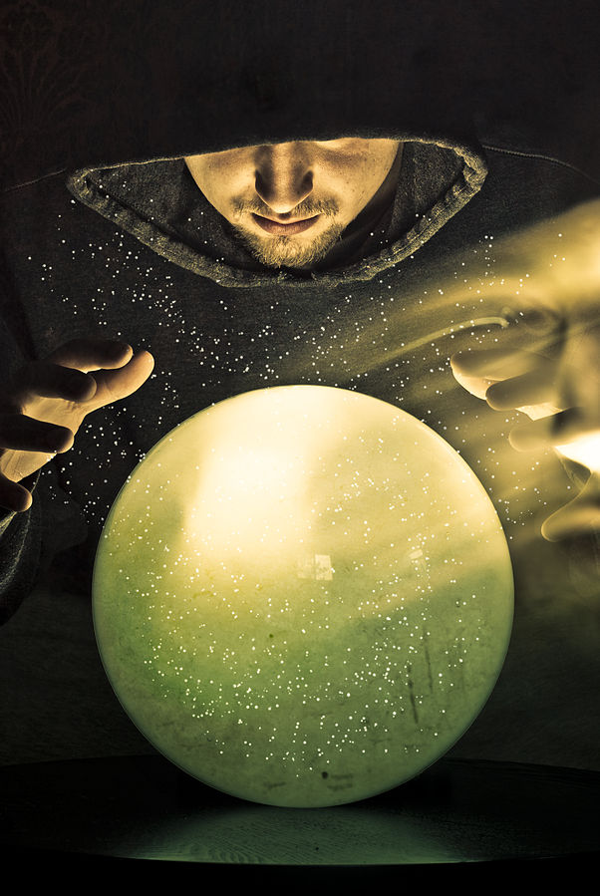
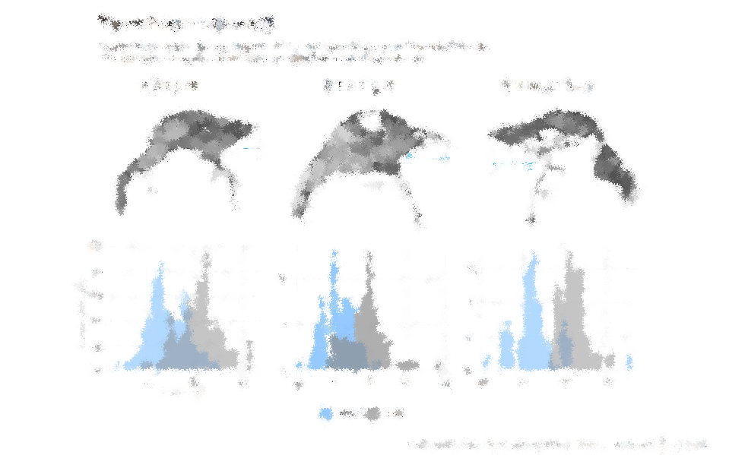
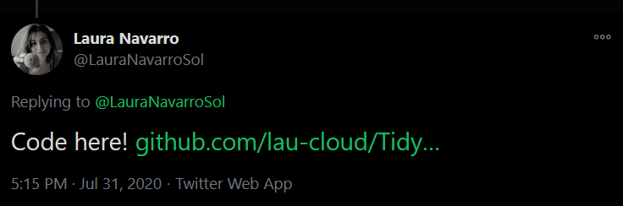

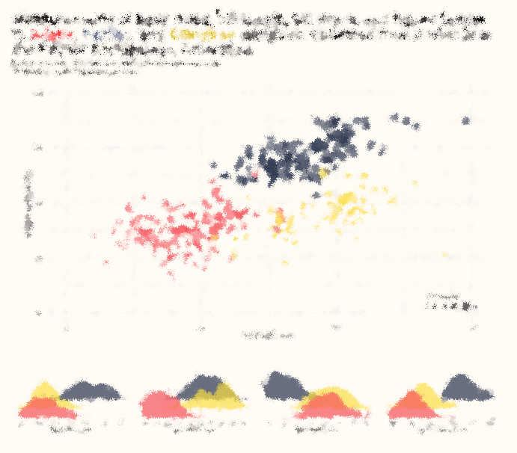
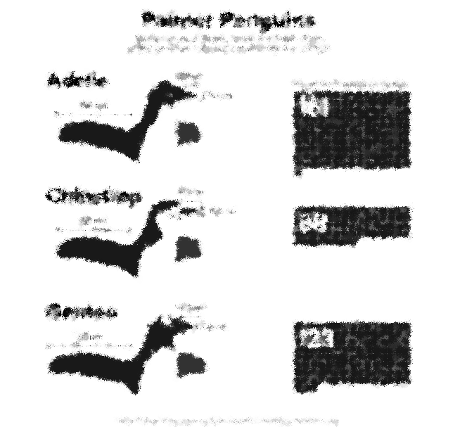
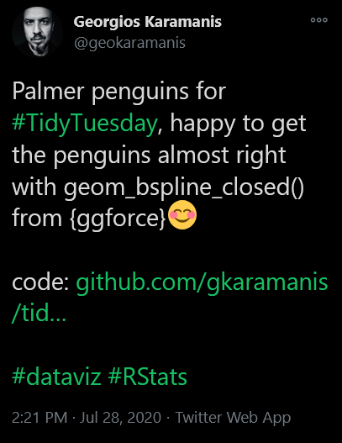
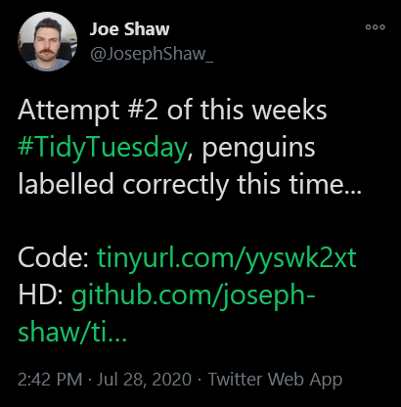
Text styling
Include images
#TidyTuesday Contributions by ← myself ↖ Laura Navarro ↙ Joe Shaw ↓ Georgios
#TidyTuesday Contributions by ← myself ↖ Laura Navarro ↙ Joe Shaw ↓ Georgios Karamanis
Annotations
Legend design
Color choice
Spacing
Combining geoms
Unusual geoms
Combining multiple plots
Image by Sean McGrath
Notes:
Fortunately, these plots are not the result of magic but code.
And even luckier is the circumstance that many R and ggplot2 users are comiting theirselves to the open-source philosophy and share their code and ideas publicly, most likely uploaded on GitHub, which allows you to explore the functions and packages used to create these advanced ggplots.
All the charts that I´ve shown you here are contribuitons to …

Slide 8
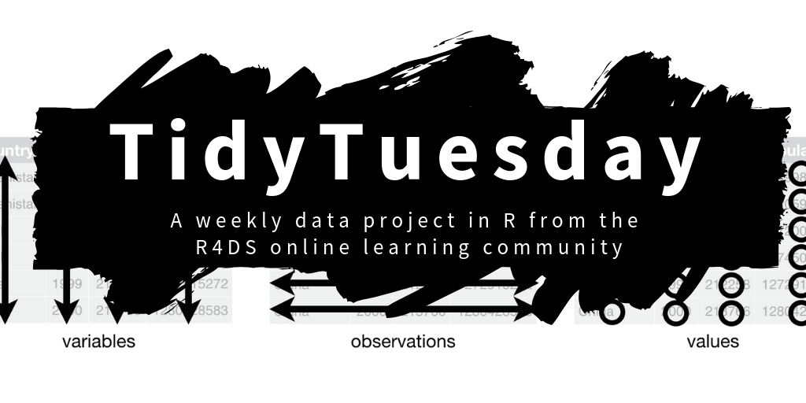
#TidyTuesday on Twitter • rfordatascience/tidytuesday on GitHub • R4ds on Slack
Notes:
… the awesome TidyTuesday challenge from the R4DataScience community which is a weekly data project similar to MakeoverMonday but aimed at the R ecosystem. Each week a dataset is shared by Thomas Mock and the community is invited to summarize and arrange the data to make meaningful charts with ggplot2.
While TidyTuesday is a great way of training data preparation and visualization — as it was especially helpful for me to expand my skill set and to build portfolio and network — it is also a commitment in terms of time and creativity to dive into a new data set and design every week.

Slide 9

“I’m not looking to necessarily practice my skills as much as I am to be inspired and know what I can do based on what other people share.”
P3 in Proc. ACM Hum.-Comput. Interact. 37, 4, Article 111
#TidyTuesday on Twitter • rfordatascience/tidytuesday on GitHub • R4ds on Slack
Notes:
But even in case you have no time or interest to contribute actively, it is definitly worth to check out the project to be inspired and to know what one can do with ggplot2 based on what other people share.

Slide 10
“#TidyTuesday became a ‘choose your own adventure game’, which allowed participants to ‘pursue something really weird’ beyond traditional visualizations.”
“I’m not looking to necessarily practice my skills as much as I am to be inspired and know what I can do based on what other people share.”
P3 in Proc. ACM Hum.-Comput. Interact. 37, 4, Article 111
I17 and P16 in Proc. ACM Hum.-Comput. Interact. 37, 4, Article 111
#TidyTuesday on Twitter • rfordatascience/tidytuesday on GitHub • R4ds on Slack
Notes:
It can also serve as a playground to try untraditional chart types and designs and maybe also to pursue something really weird beyond traditional visualizations. You can spend a lot of time or limit it to one hour – the most improtant thing is to learn and train different things.

Slide 11
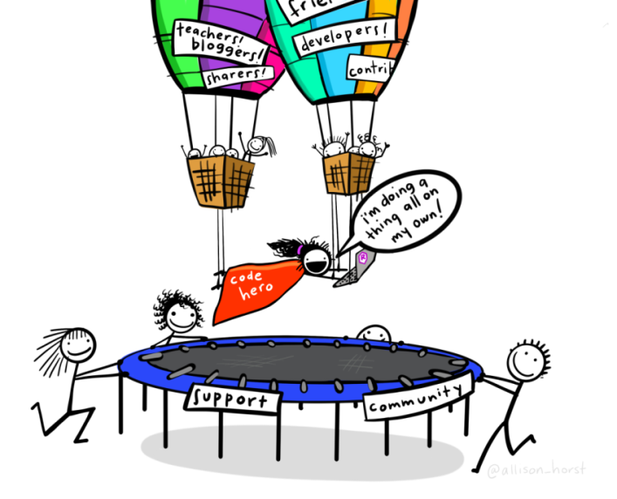
Notes:
To get there it´s all about the community: package developers, people writing blogs, sharing their sources and creativity. This in turn can serve as help and starting point for others and the ideas may turn into new packages.

Slide 12
The Showcase
with the help of
{ggdist} & {ggtext} & {patchwork}
🔗 mjskay.github.io/ggdist
My Contribution to #TidyTuesday 2020/31
🔗 wilkelab.org/ggtext/
🔗 patchwork.data-imaginist.com
Notes:
My visualization of the Penguin dataset for example wouldn´t havebeen possible without the help of developers that created ggplot2 and extensions packages, here namely ggdist, ggtext and patchwork.

Slide 13
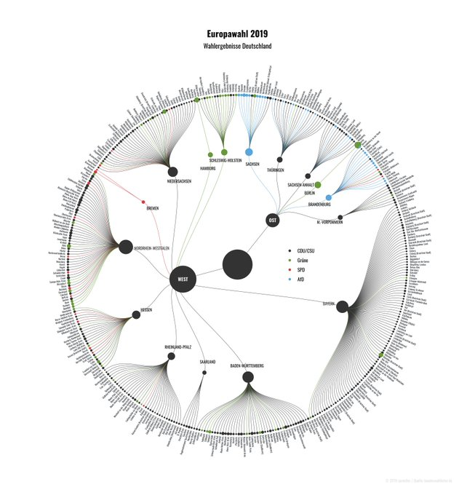
The Showcase
Tree Diagrams + Networks
with the help of
{ggraph}
🔗 ggraph.data-imaginist.com
Thorsten Sprenger
Notes:
With the help of extension packages, one can also create tree diagrams and networks, …

Slide 14
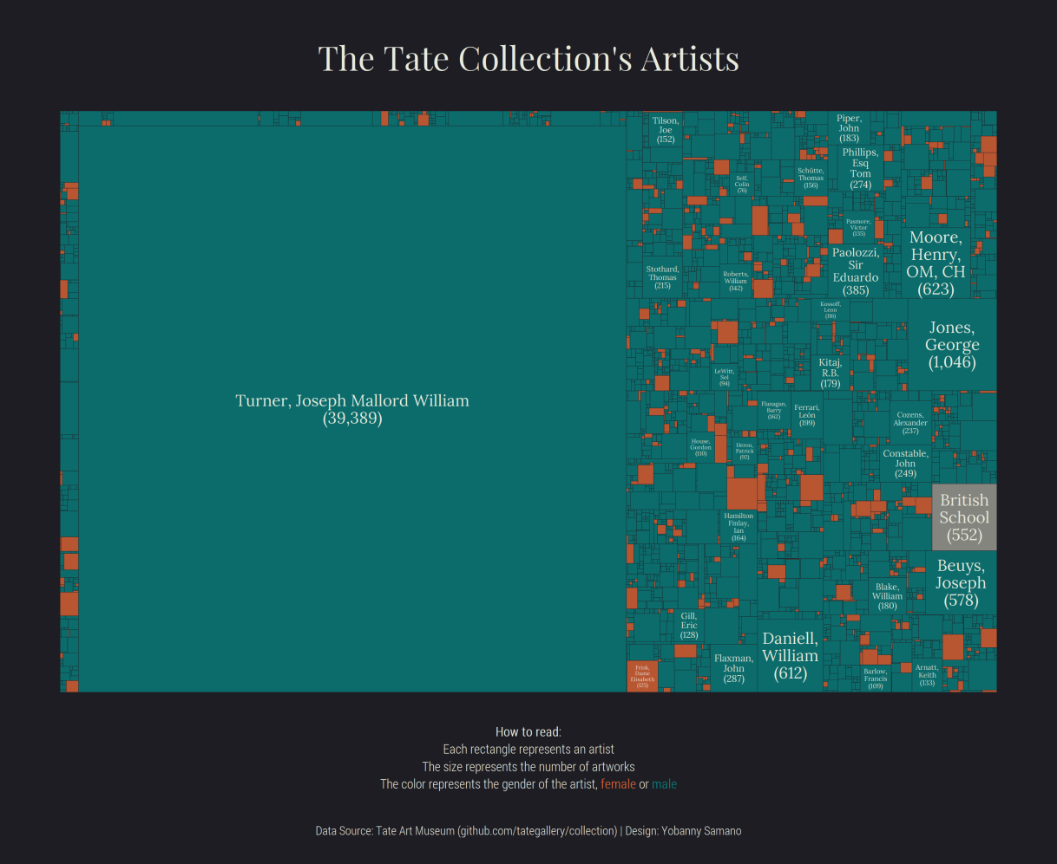
The Showcase
Treemaps
with the help of
{treemapify}
🔗 github.com/gwilkox/treemapify
Yobanny Sámano, #TidyTuesday 2021/03
Notes:
… wonderful treemaps…

Slide 15
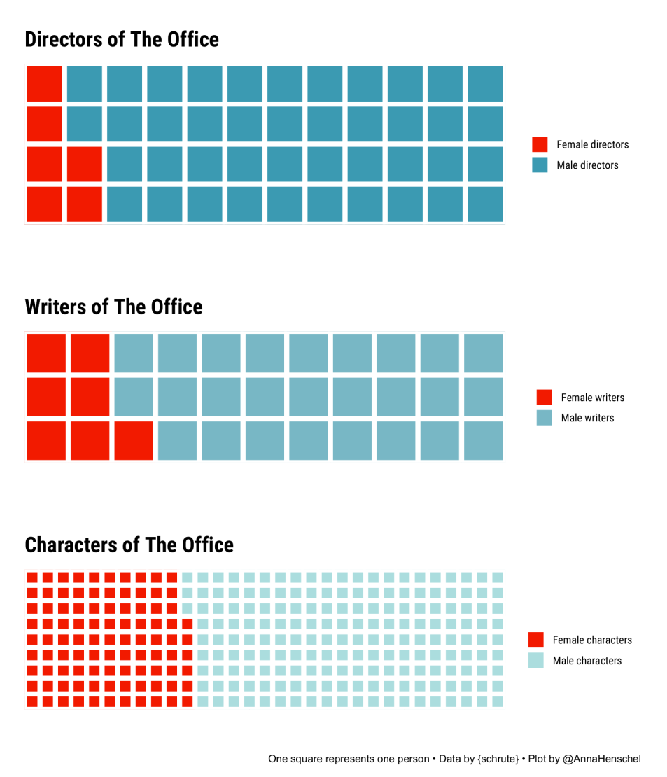
The Showcase
Waffle Charts
with the help of
{waffle}
🔗 github.com/hrbrmstr/waffle
Anna Henschel, #TidyTuesday 2020/12
Notes:
… waffle charts …

Slide 16
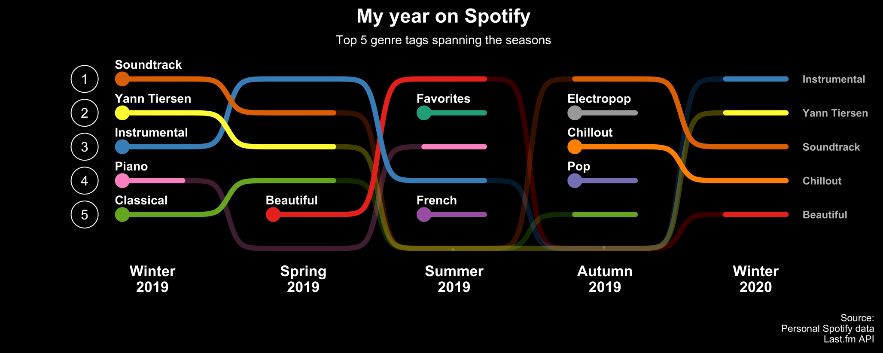
The Showcase
Bump Charts
with the help of
David Söjberg
{ggbumb}
🔗 github.com/davidsjoberg/ggbump
Notes:
… bump charts to compare rankings over time …

Slide 17
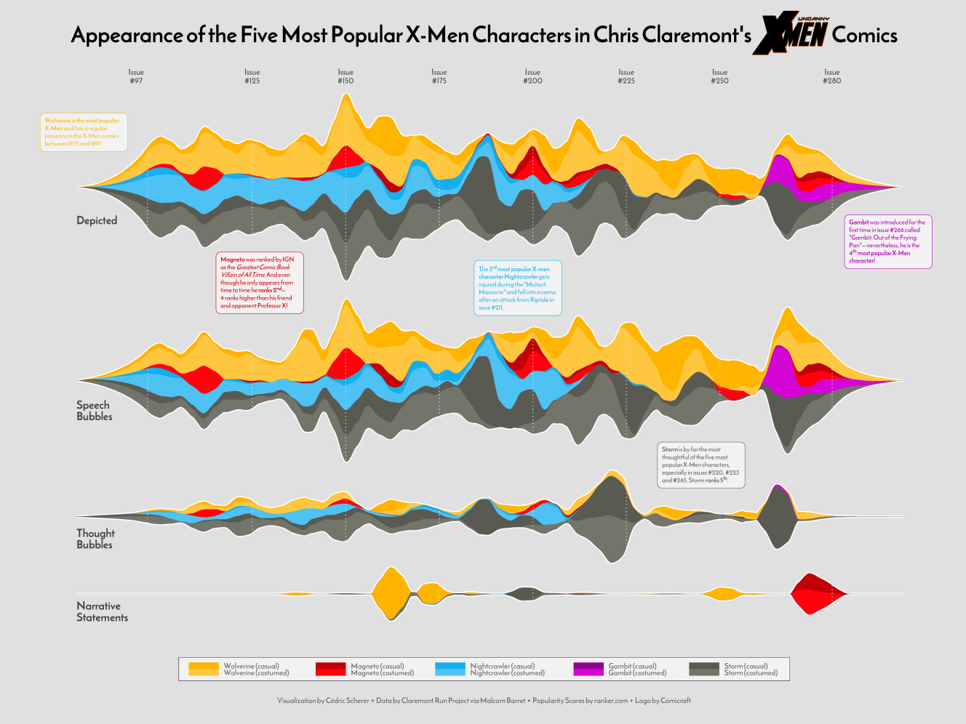
The Showcase
Streamgraphs
with the help of
{ggstream}
🔗 github.com/davidsjoberg/ggstream
My Contribution to #TidyTuesday 2020/27
Notes:
… visualize changes over time by using streamgraphs, …

Slide 18
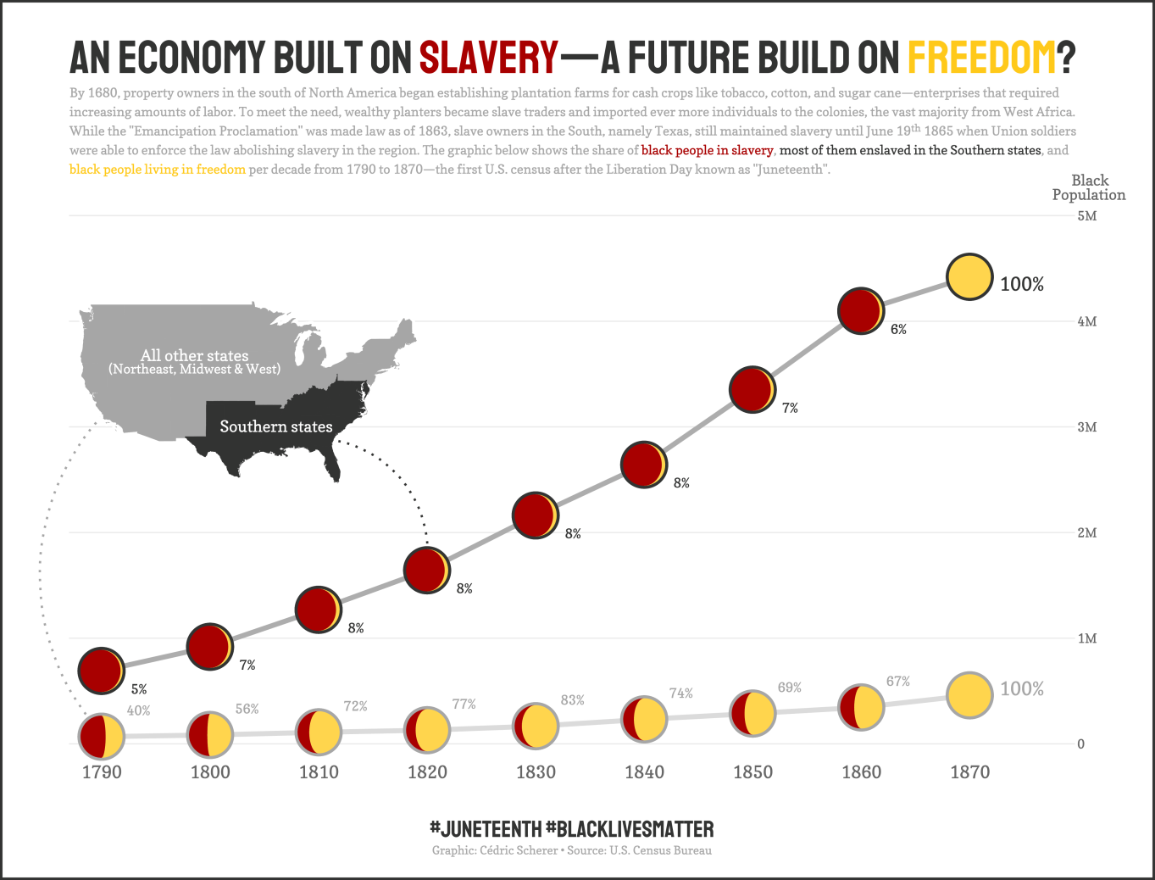
The Showcase
Streamgraphs
with the help of
{gggibbous}
My Contribution to #TidyTuesday 2020/25
🔗 github.com/mnbram/gggibbous
Notes:
… or moon charts as a useful and visually appealing alternative for pie charts.

Slide 19
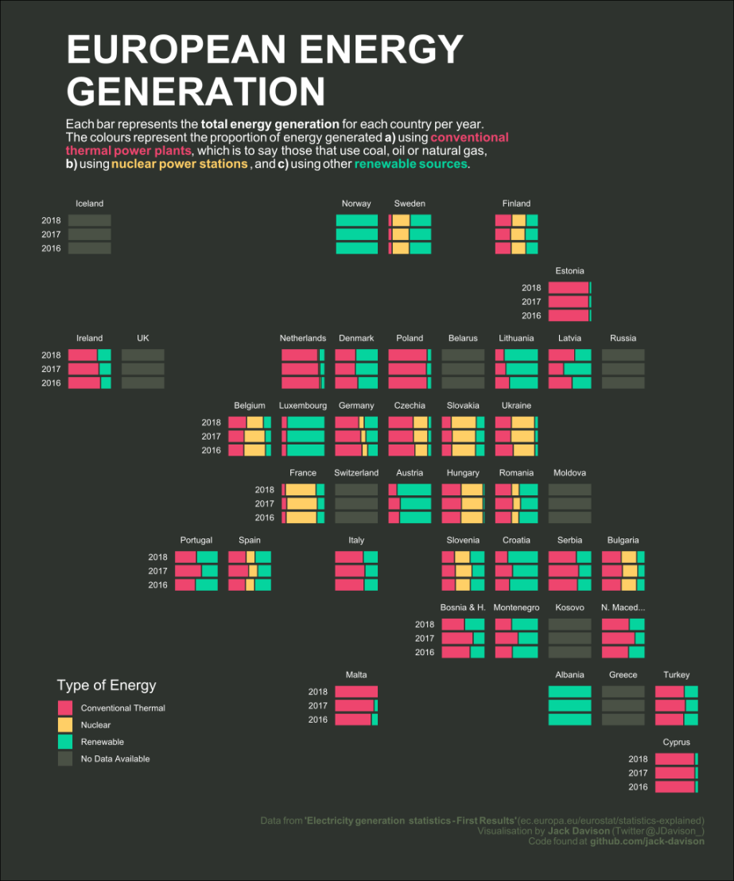
The Showcase
Geofacets
with the help of
{geofacet}
🔗 hafen.github.io/geofacet
Jack Davison, #TidyTuesday 2020/32
Notes:
The geofacet package offers a simple way of drawing small multiples as grid tile maps, as this one resembling Europe, and of course…

Slide 20
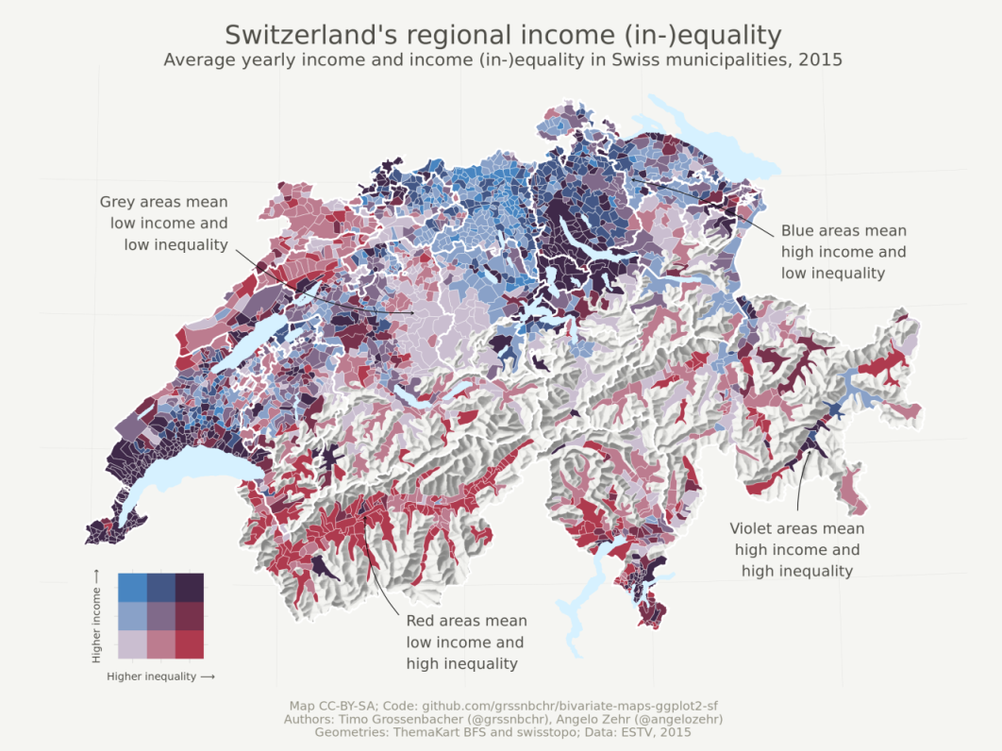
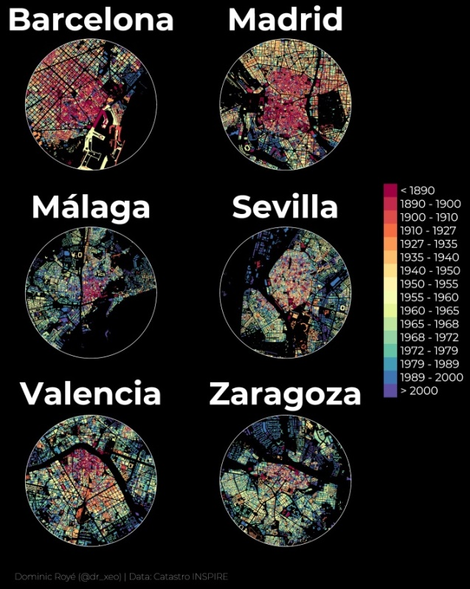
The Showcase
Maps
Timo Gossenbacher (timogrossenbacher.ch/2019/04/bivariate-maps-with-ggplot2-and-sf)
Dominic Royé (dominicroye.github.io/en/2019/visualize-urban-growth/)
with the help of
{sf}
🔗 r-spatial.github.io/sf
Notes:
… ggplot2 can also handle true spatial data and is, thanks to the sf package, capable of creating wonderful maps as illustrated by these two wonderful examples, …

Slide 21
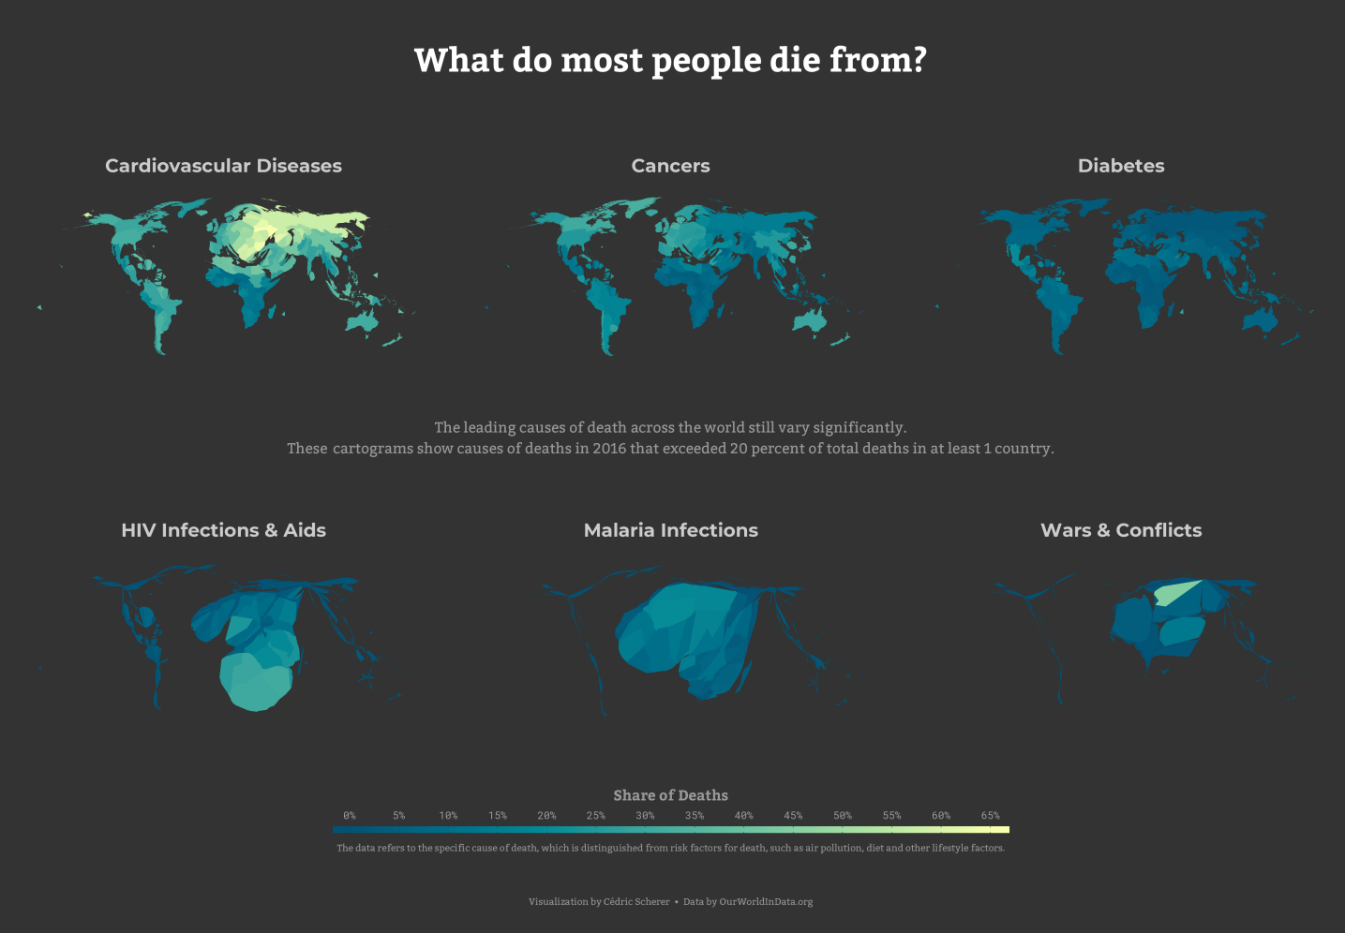
The Showcase
Cartograms
with the help of
{cartogram}
🔗 github.com/sjewo/cartogram
My Contribution to the #30DayMapChallenge 2019, Topic Polygons
Notes:
… and even distorted maps, called cartograms, a technique I used as a contribution for the first 30DayMapChallenge to highlight biases in leading causes of death across the world.

Slide 22
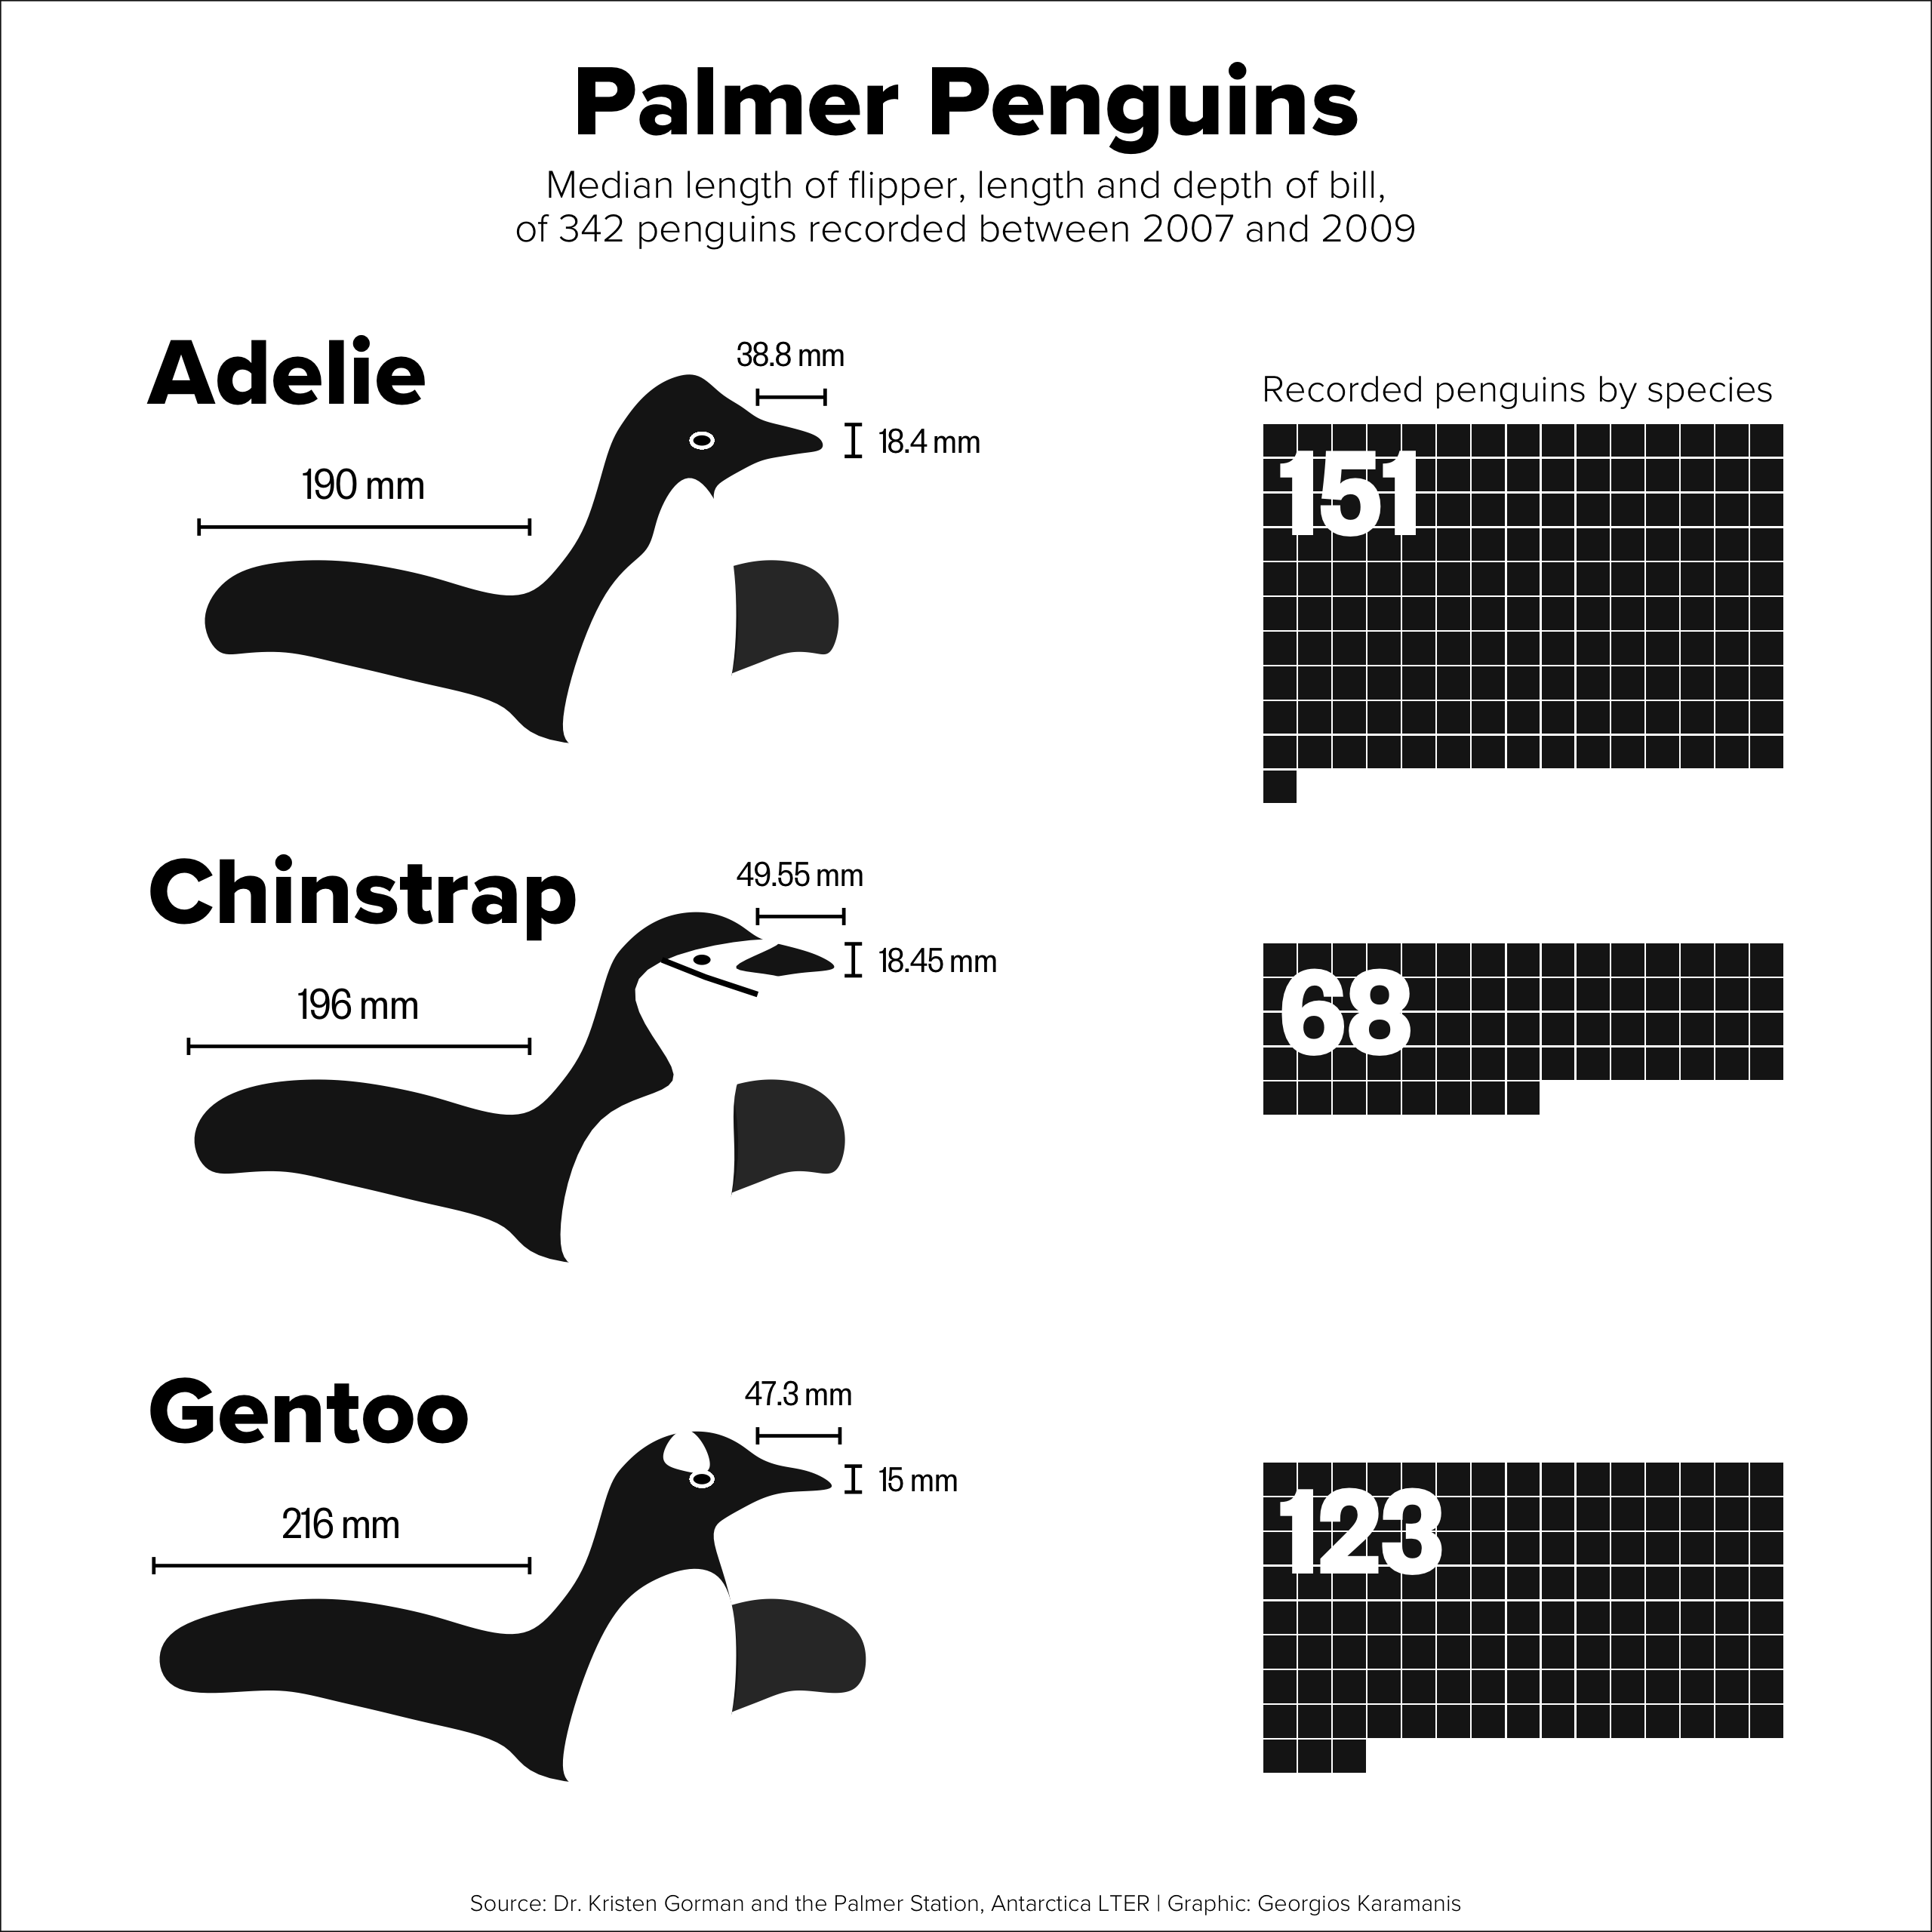
The Showcase
Drawings
with the help of
{ggforce}
🔗 ggforce.data-imaginist.com
Georgios Karamanis
Notes:
With a bit of effort and creativity, ggplot2 can also be used to draw penguins, …

Slide 23
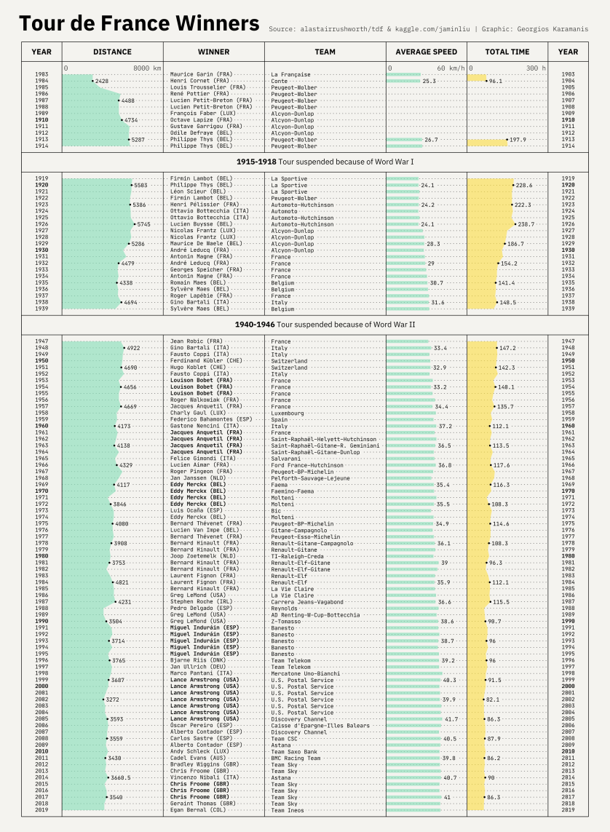
The Showcase
Tables
Georgios Karamanis, #TidyTuesday 2020/15
Notes:
create tables with visual cues…

Slide 24
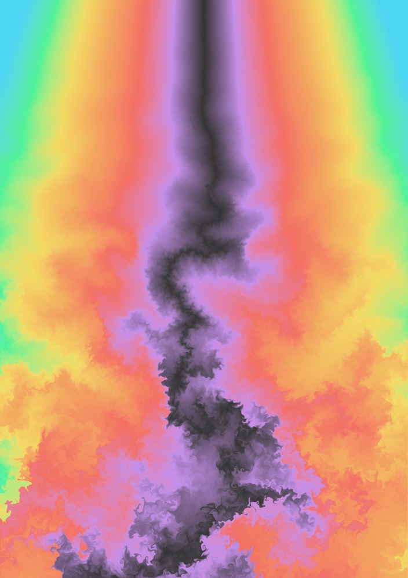
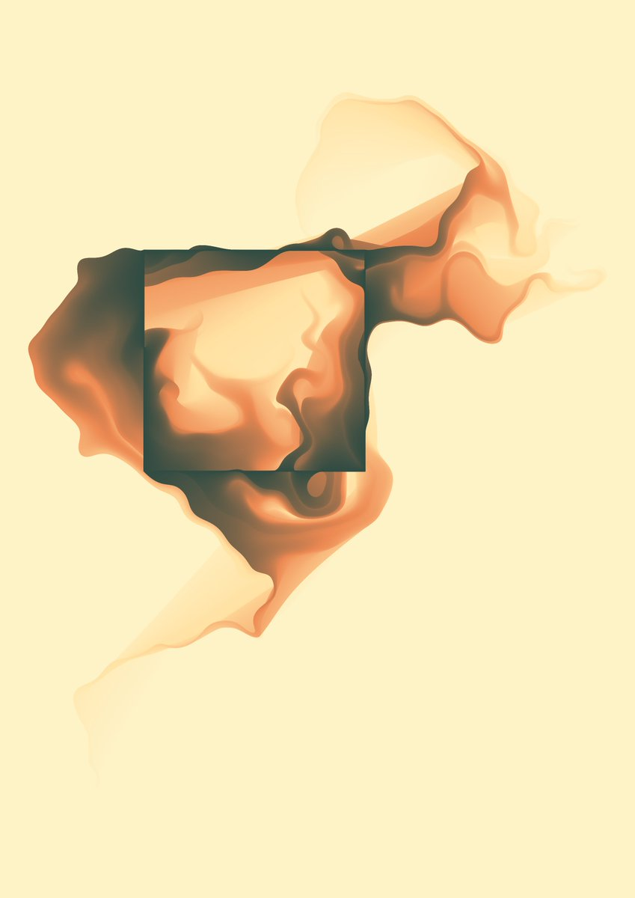


The Showcase
Generative Art
with the help of
Thomas Lin Pedersen
Notes:
… or generative art such as these wonderful pieces by Thomas Pedersen.
Given the almost unlimited possibilities, I was curious to see which geometries I‘ve used the most in my Tidytuesday contributions.

Slide 25
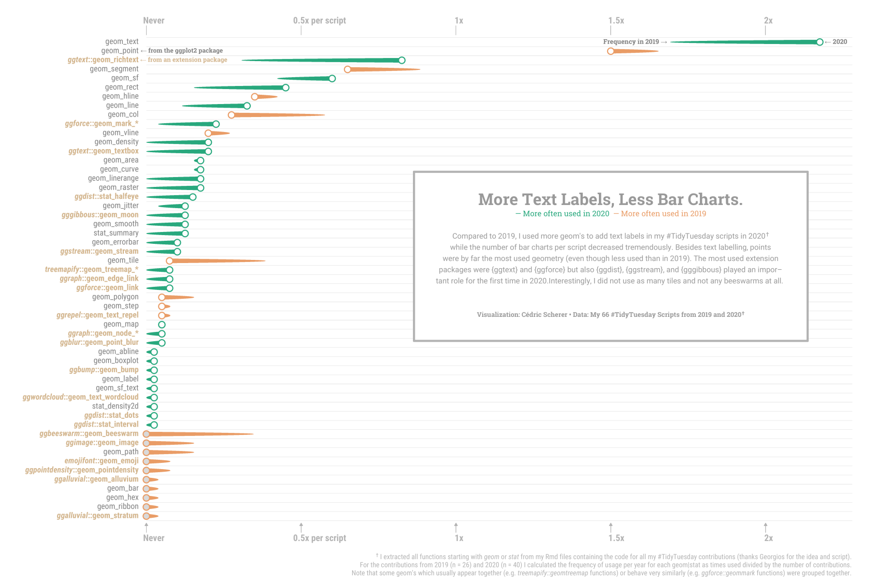
Notes:
This chart, of course created with ggplot, highlights the overall usage of ggplot geometries in 2020 and the change compared to my plots from 2019.

Slide 26
Notes:
Interestingly, I used on average 3.5 geometries per script that draw additional text labels (which can lead to many more labels, depending on how you use them)!
So the first packages I want to highlight in this talk are two I used a lot for annotations, namely ggtext and ggforce.

Slide 27
{ggtext}
Improved Text Rendering Support
🔗 wilkelab.org/ggtext
Notes:
ggtext is an extension package developed by Claus Wilke and it introduces two new theme elements and two new geometries that provide text rendering for ggplot2.

Slide 28
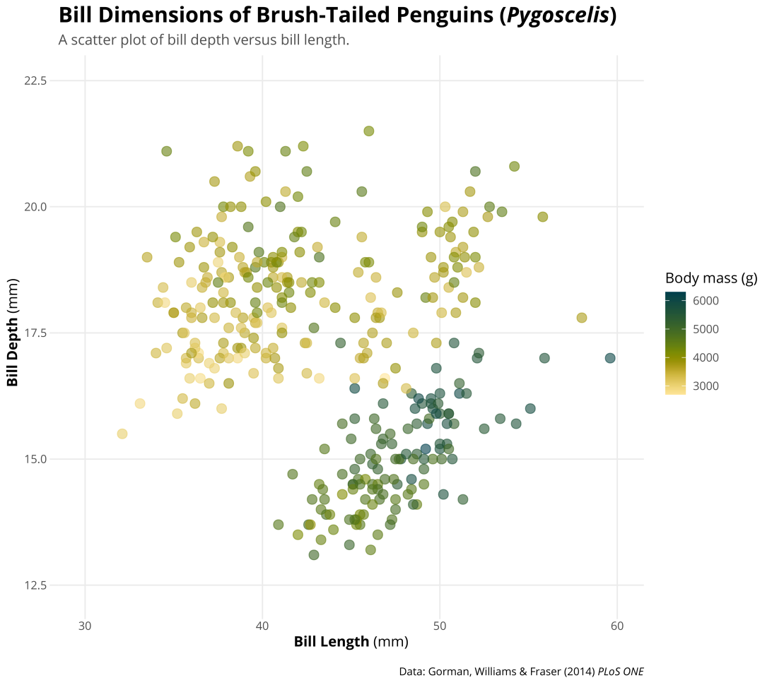
{ggtext} Improved Text Rendering Support
element_markdown() → formatted text elements, e.g. titles, caption, axis text, striptext
ggplot(data = df_penguins, aes(x = bill_length_mm, y = bill_depth_mm)) + geom_point(aes(color = body_mass_g), alpha = .6, size = 3) + labs(title = "Bill Dimensions of Brush-Tailed Penguins *Pygoscelis*",
caption = "Data: Gorman, Williams & Fraser (2014) *PLoS ONE*",
x = "**Bill Length** (mm)", y = "**Bill Depth** (mm)") +
theme_minimal()
Notes:
Lets go back to our customized scatterplot of bill dimensions. One thing that particularly bothers me as a Biologist is the non-italic name of the penguin Genus in the title.
Here, the ggtext package comes into play which allows us to turn it into italic font
by using markdown syntax: text wrapped in single asterisks turns into italic while two asterisks return bold text. To illustrate that, I also modified the caption and axis titles.

Slide 29
{ggtext} Improved Text Rendering Support
element_markdown() → formatted text elements, e.g. titles, caption, axis text, striptext
ggplot(data = df_penguins, aes(x = bill_length_mm, y = bill_depth_mm)) + geom_point(aes(color = body_mass_g), alpha = .6, size = 3) + labs(title = "Bill Dimensions of Brush-Tailed Penguins *Pygoscelis*",
caption = "Data: Gorman, Williams & Fraser (2014) *PLoS ONE*",
x = "**Bill Length** (mm)", y = "**Bill Depth** (mm)") +
theme_minimal() +
theme(plot.title = element_markdown(face = 'bold‘),
plot.caption = element_markdown(margin = margin(t = 15)),
axis.title.x = element_markdown(),
axis.title.y = element_markdown())
Notes:
To make it work, you need to turn the respective theme elements for title, caption and axis title into `element_markdown()` and you are done.

Slide 30
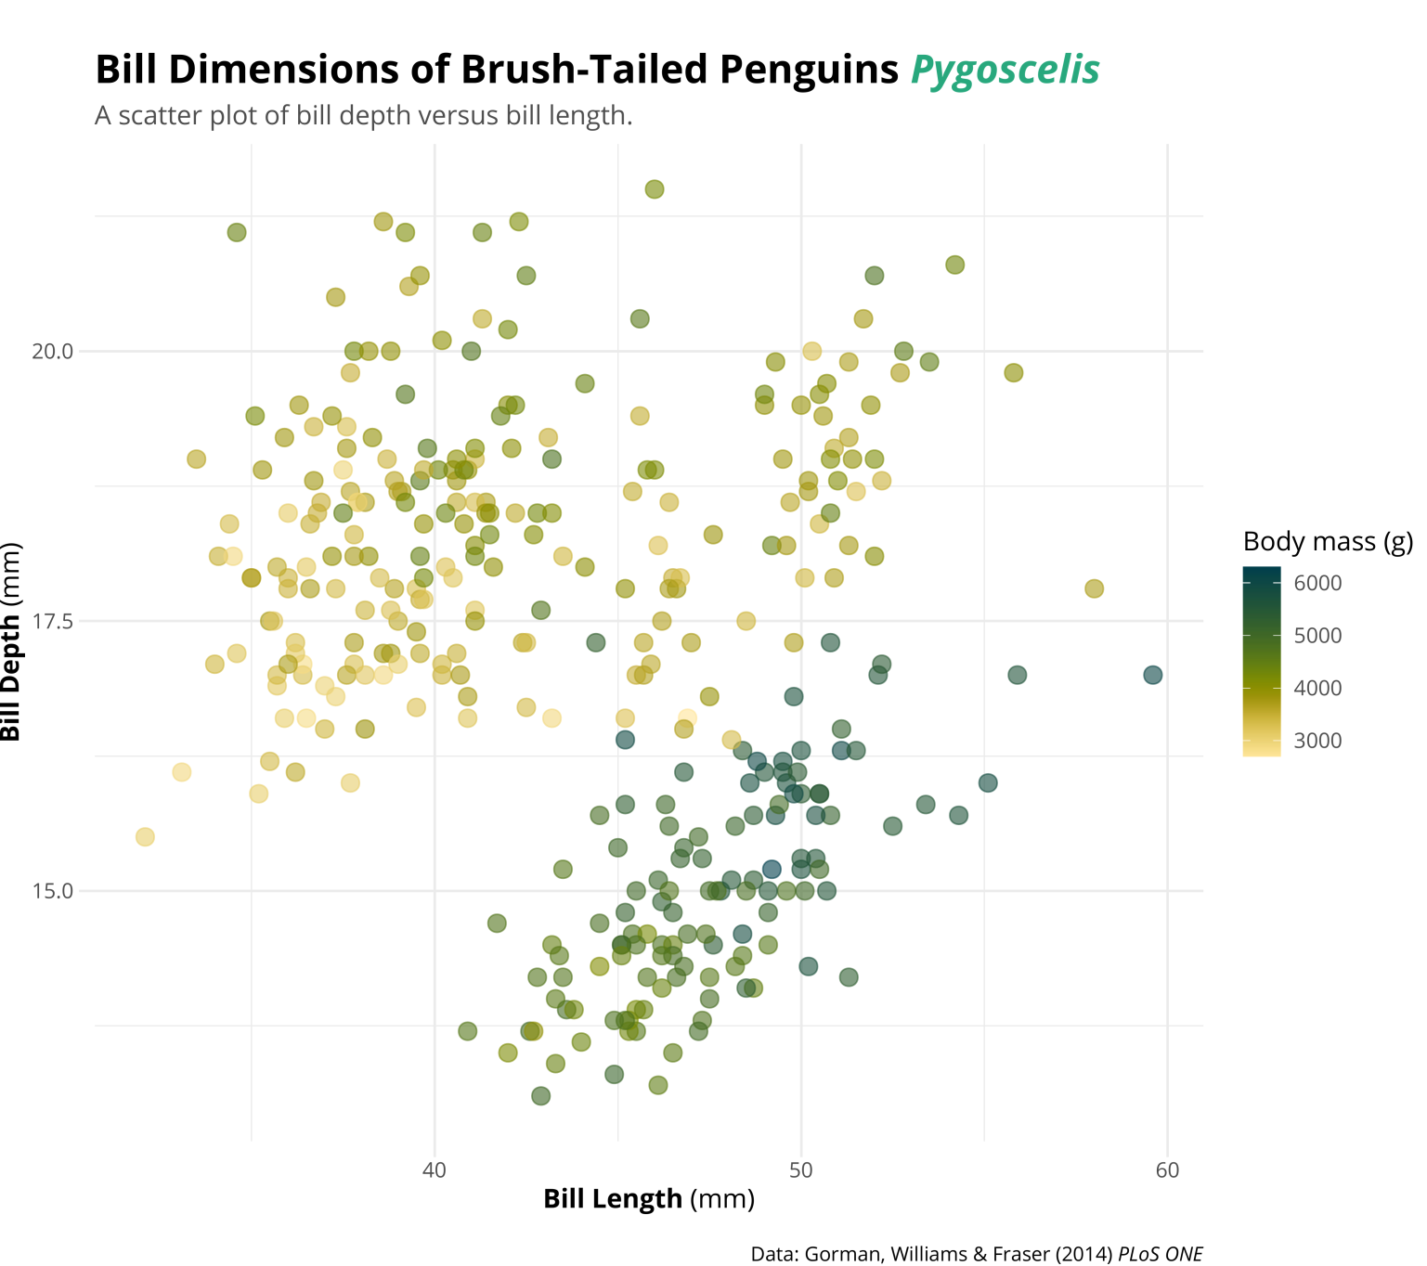
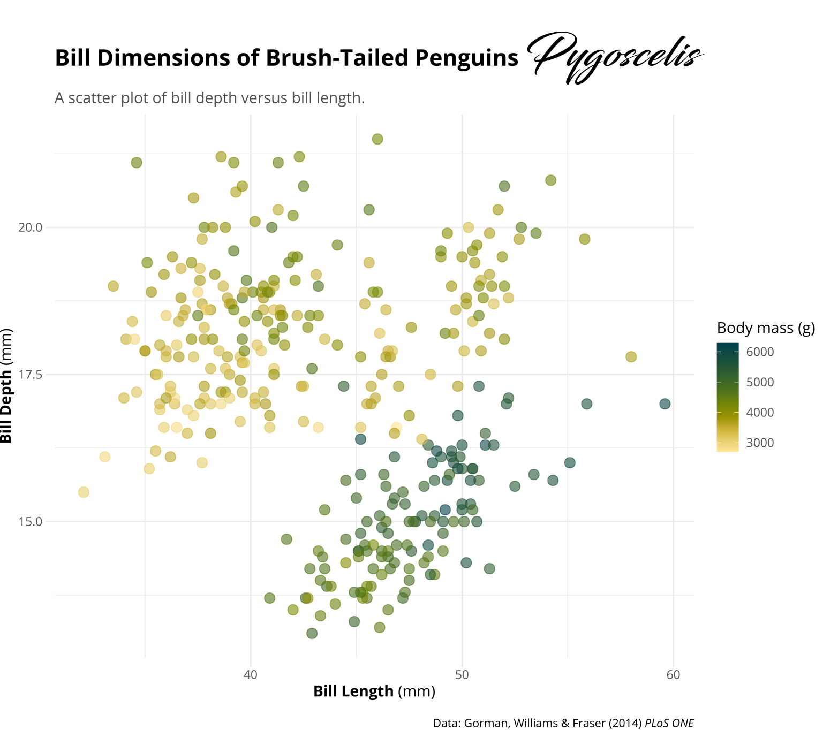

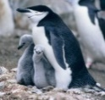
{ggtext} Improved Text Rendering Support
<i style='color:#28A87D;'>Pygoscelis</i>
<b style='font-size:32pt;font-family:blacksword;'>Pygoscelis</b>
<img src='https://cedricscherer.com/img/pygoscelis.jpg'‚ width='10'/>
Notes:
One can also use the ggtext package to highlight particular bits by using HTML encodings inside the title string.
This way, we can also manipulate the font size, family, lineheight and a few more.
It is even possible to include images via the img HTML tag which is helpful if you want to use icons or other images as axis text.

Slide 31
{ggtext} Improved Text Rendering Support
<i style='color:#28A87D;'>Pygoscelis</i>
<b style='font-size:32pt;font-family:blacksword;'>Pygoscelis</b>
<img src='https://cedricscherer.com/img/pygoscelis.jpg'‚ width='10'/>
Notes:
(However, I have to admit that this is currently not working on windows machines as it seems.)

Slide 32
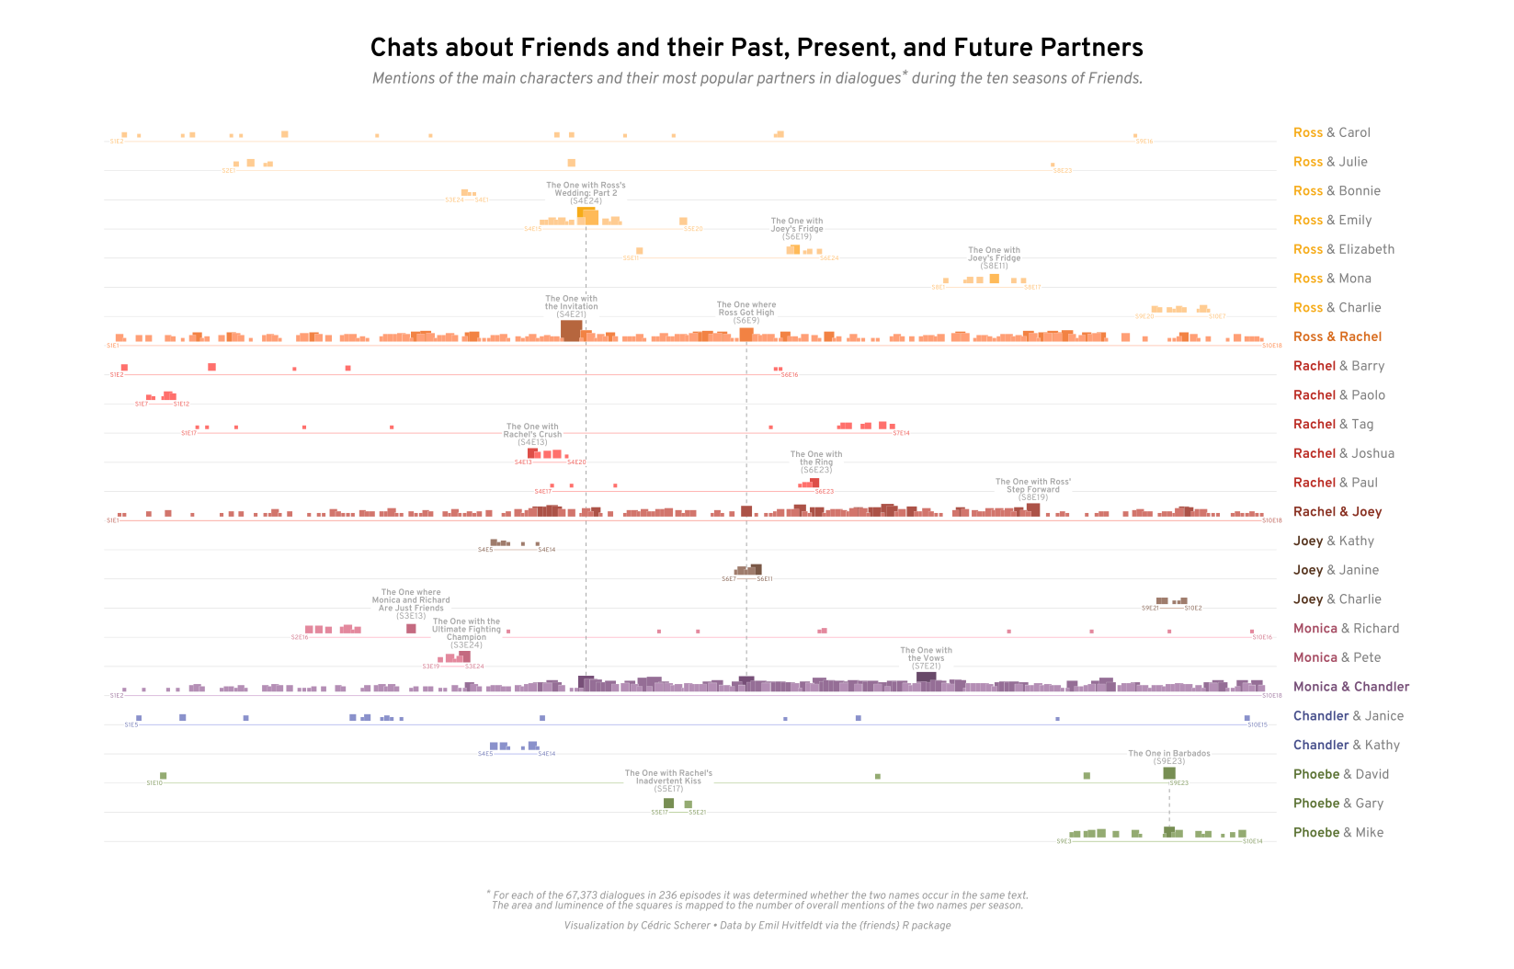
Font Color Font Face
<b style='color:#d86b1d;'>Ross & Rachel</b> <b style='color:#ba2a22;'>Rachel</b> & Barry
Contribution to #TidyTuesday 2020/37
Notes:
In this visualization of the TV series FRIENDS I used HTML to highlight the main character of Friends along the y axis with bold, colored text.

Slide 33
Font Color Font Face
label = if_else(
key %in% c("Ross & Rachel", "Rachel & Joey", "Monica & Chandler"),
glue::glue("<b style='color:{color};'>{partners}</b>"),
stringr::str_replace(partners, key, glue::glue("<b style='color:{color};'>{key}</b>"))
)
<b style='color:#d86b1d;'>Ross & Rachel</b> <b style='color:#ba2a22;'>Rachel</b> & Barry
partners | key | color | label
Ross & Rachel | Ross & Rachel | #d86b1d | <b style='color:#d86b1d;'>Ross & Rachel</b>
Chandler & Janice | Chandler | #48508c | <b style='color:#48508c;'>Chandler</b> & Janice
Ross & Carol | Ross | #f6ab18 | <b style='color:#f6ab18;'>Ross</b> & Carol
Contribution to #TidyTuesday 2020/37
Notes:
The formatting can be done dynamically with the help of a simple if_else statement. For everyone interested I show the code here but will not explain detailed steps.
ggtext comes with three more functions that all work with markdwon and HTML syntax I just showed you.

Slide 34
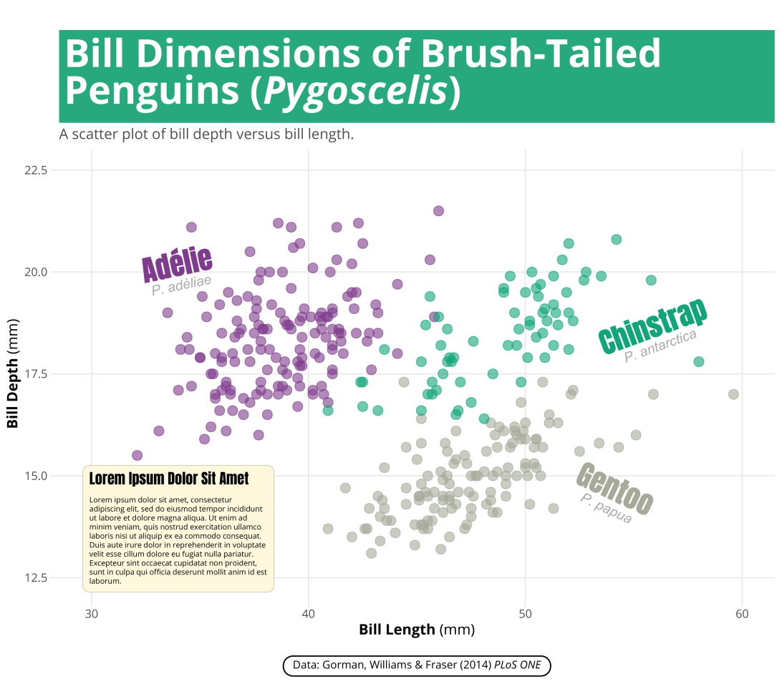
{ggtext} Improved Text Rendering Support
element_markdown() → formatted text elements, e.g. titles, caption, axis text, striptext
geom_richtext() → formatted text labels with 360° rotation
element_textbox() and element_textbox_simple() → formatted text boxes with word wrapping
geom_textbox() → formatted text boxes with word wrapping
Notes:
geom_richtext allows to draw text labels similar to geom_text but with rendered text and, if you like, full 360° rotation.

Slide 35
{ggtext} Improved Text Rendering Support
element_markdown() → formatted text elements, e.g. titles, caption, axis text, striptext
geom_richtext() → formatted text labels with 360° rotation
element_textbox() and element_textbox_simple() → formatted text boxes with word wrapping
geom_textbox() → formatted text boxes with word wrapping
Notes:
Similar to element_markdown, element_textbox can be use to replace text elements and add a box with word wrapping as the title and the caption illustrate…

Slide 36
{ggtext} Improved Text Rendering Support
element_markdown() → formatted text elements, e.g. titles, caption, axis text, striptext
geom_richtext() → formatted text labels with 360° rotation
element_textbox() and element_textbox_simple() → formatted text boxes with word wrapping
geom_textbox() → formatted text boxes with word wrapping
Notes:
… and geom_textbox provides the same functionaility for text labels.

Slide 37
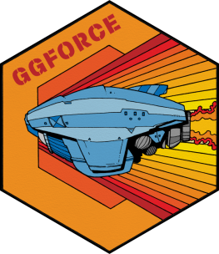
{ggforce}
Providing Missing Functionality to ggplot2
🔗 ggforce.data-imaginist.com
Notes:
Next up is ggforce, a package developed by Thomas Pedersen that provides a vast range of functionailty to ggplot.

Slide 38
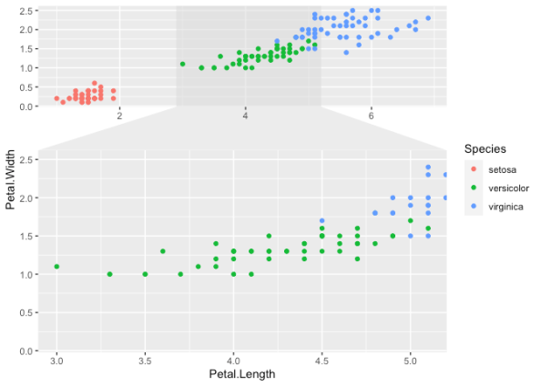
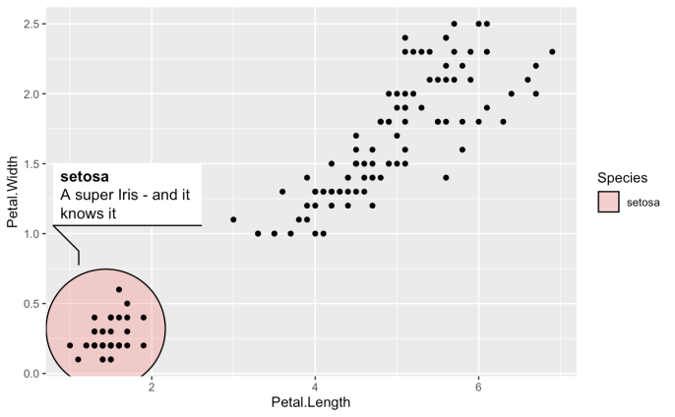
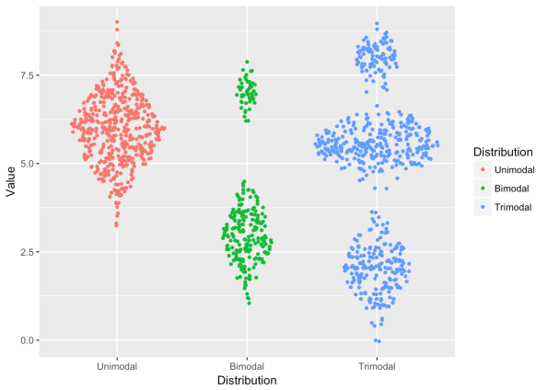
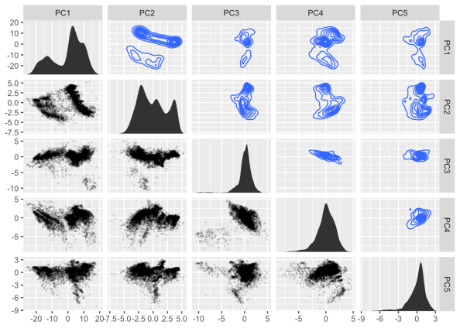
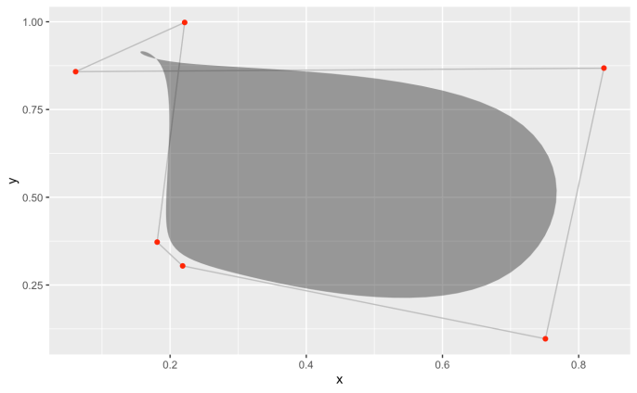
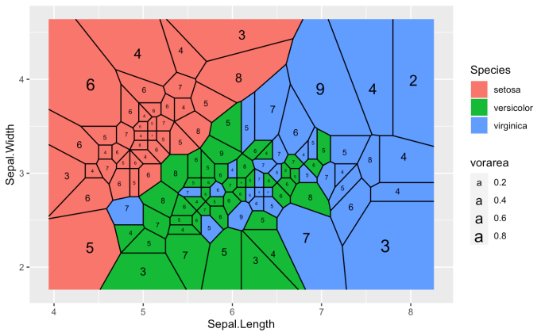
{ggforce} Providing Missing Functionality
Notes:
Here is just a snapshot of some of the awesome functions that ggforce adds to your ggplot tool box: facets to zoom in, sina plots and voronoi maps to just name a few.

Slide 39
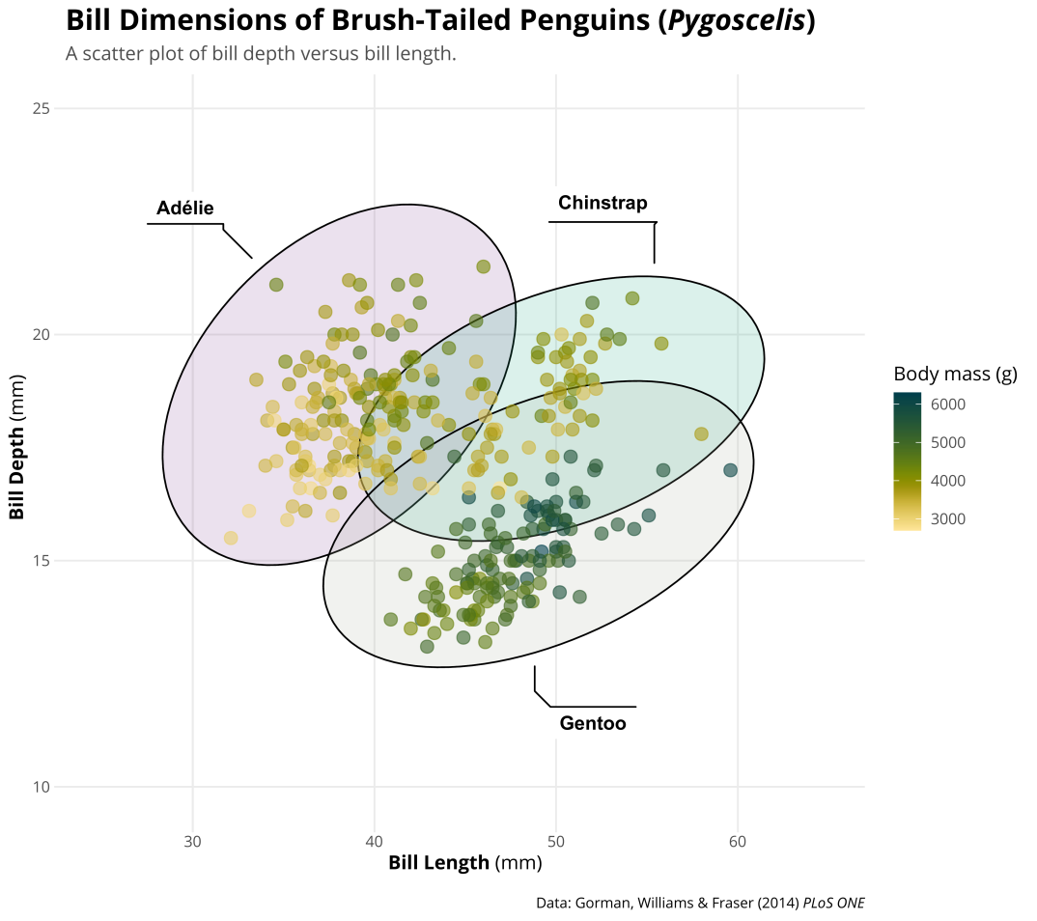
{ggforce} Fancy Annotations
geom_mark_*() → advanced labels for single or multiple points
geom_mark_ellipsoid(aes(fill = species, label = species))
Notes:
I most often used functions from the geom_mark family that draw advanced labels and can be used to show all groups at once

Slide 40
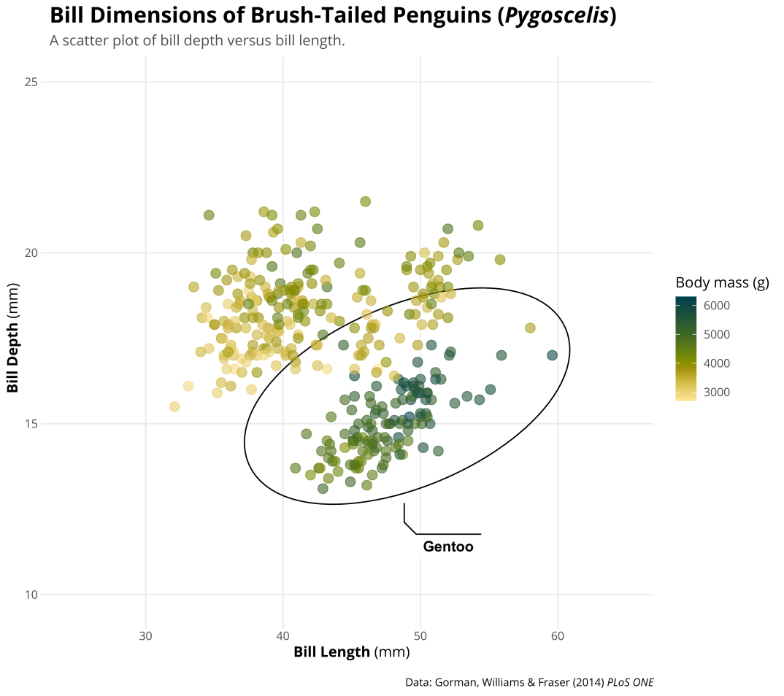

{ggforce} Fancy Annotations
geom_mark_*() → advanced labels for single or multiple points
→ show all groups or highlight interesting parts
geom_mark_ellipsoid(aes(fill = species, label = species, filter = species == 'Gentoo'))
Notes:
… or to highlight interesting subgroups.

Slide 41
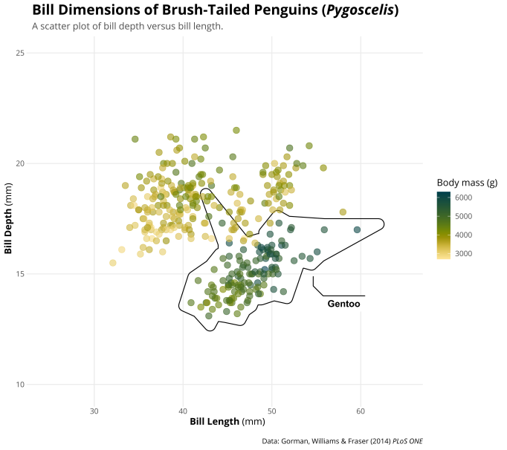
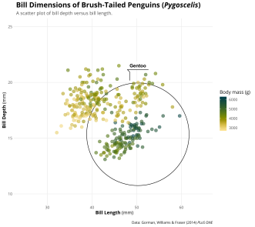

{ggforce} Fancy Annotations
geom_mark_*() → advanced labels for single or multiple points
→ show all groups or highlight interesting parts
geom_mark_hull()
geom_mark_ellipsoid()
geom_mark_circle()
geom_mark_rect()
Notes:
… and it comes in four different versions with the hull function being a very interesting one.

Slide 42

Jake Kaupp
Notes:
This way you can create charts with wonderful and detailed text labels as illustrated by Jake Kaupp in this example…

Slide 43

geom_mark_*(expand = unit(.1, "mm"),
con.cap = unit(0, "mm"))
Customer survey Kuendigung.org (kuendigung.org/studien/verbraucherumfrage-zur-zukunft-nach-der-krise)
Notes:
… and you can also use only the fancy annotation without the geometry by changing the default arguments. Here, I used it for direct labelling of the two categories to visualize survey results.

Slide 44
Notes:
Another package that definitely belongs to my favorites and which I use regularly is ggdist by Matthew Kay.

Slide 45
{ggdist}
Visualizations of Distributions and Uncertainty
🔗 mjskay.github.io/ggdist

Slide 46

{ggdist} Visualizations of Distributions and Uncertainty
Notes:
ggdist comes with a suite of well-chosen chart types to visualize distributions and uncertainty. All of them are great, but I want to highlight
Three functions I use often to visualize distributions: halfeyes, interval strips and dot plots.

Slide 47



stat_dots()
stat_interval()
geom_text()
geom_point()
Contribution to #TidyTuesday 2020/28
Notes:
In my visualization of coffee ratings by the Coffee Quality Institute
I combined dots that show individual ratings of coffee beans with intervals showing the summary stats per country.
In addition, I added triangles and labels for median and lowest ratings per country via geom_point() and geom_text().

Slide 48

stat_interval()
stat_halfeye()
Contribution to the SWD Challenge September 2019
Notes:
In another contribution, I used again intervals, now in combination with distributions drawn with stat_halfeye to visualize monthly temperature ranges in Berlin.

Slide 49

{ggplot2}
Details You May Not Know Yet (or have never thought about)
🔗 ggplot2.tidyverse.org
Notes:
For the last part of my talk, I want to focus on the ggplot2 package itself and tell you about some changes you can apply to improve your plot that you may not know yet or did never think about to change it in the first place.

Slide 50

Left-Aligned Title?
theme(plot.title = element_text(hjust = 0))
Notes:
Let‘s have a look again at our scatterplot of bill depth versus bill length with text rendering thanks to ggtext and fancy annotations via ggforce.
The first detail that we can fix is the alignement of the title. Yes, by default the horizontal justification is set to left-aligned — however, we see that there is some gap between the title and the margin.

Slide 51

Left-Aligned Title
Default
Better
theme(plot.title.position = 'panel')
theme(plot.title.position = 'plot')
Notes:
This is because the title is aligned with the panel by default, not with the inner margin of the plot. This becomes especially annoying in case of long labels on the y axis.
Since ggplot version 3, you can change the default for plot.title.position to plot to make it truly left-aligned.

Slide 52


Right-Aligned Caption
Default
Better (?)
theme(plot.caption.position = 'panel')
theme(plot.caption.position = 'plot')
Notes:
Similarly, we can align the caption to the margin of the plot by changing plot.caption.position.

Slide 53

Legend Design
Default
Well…
theme(legend.position = 'right')
theme(legend.position = 'plot')
Notes:
The next thing is the legend design. It is very handy that ggplot adds a legend automatically but from time to time I prefer to change the default right position.
I think it is actually a good idea to place the legend on the top of a chart since readers usually focus on the top section of a chart first and explore the lower parts of the chart afterwards. However, the legend feels a bit lost and also the labels are very narrow.

Slide 54

Legend Design
Default
Better!
guides(color = guide_colorbar(...))
guides(color = guide_colorbar(title.position = 'top', title.hjust = .5,
barwidth = unit(20, 'lines'), barheight = unit(.5, 'lines')))
Notes:
By using the guides function, we can manipulate several properties of different legend types. In our case we want to modify the colorbar guide that is showing color.
For example, I like to center the title on the top and I almost always change the bar width and heigh to make it look less defaulty. For me this version feels way more elegant.

Slide 55

Limit Expansion
Default
Without
coord_cartesian(expand = TRUE)
coord_cartesian(expand = FALSE)
Notes:
One of the things people seem to bother with quite often – why is there some spacing around the origin? It´s because the coordinate system, a cartesian one by default, has an argument called expand that is set to true.
Setting it to false removes the expansion that is added by default and spans the grid along the exact limits.

Slide 56


Geeky Details
Notes:
And here is one for the ggplot geeks – in 2018 Claus Wilke fixed something that „just gets him“.
I‘ve put the default next to it, can you spot the thing that drives Claus mad?
If not, don´t worry, you are not alone. And also I was asking this question but once you have realized what this is about it is hard to unsee it…

Slide 57


Geeky Details
Default
Without
coord_cartesian(clip = 'on')
coord_cartesian(clip = 'off')
Notes:
What Claus is referring to is the clipping of the outer parts of the grid which leads to different widths of the grid and the ticks that are drawn on top. You can simply fix it by setting clipping to off.

Slide 58


Geeky Details
Default
Without
coord_cartesian(clip = 'on')
coord_cartesian(clip = 'off')
Notes:
Another nice use case for changing the clipping default is in case you want to draw data points or text labels outside of the panel area which otherwise would get clipped.

Slide 59


White Space
Better
Default
theme(plot.margin = margin(rep(base_size/2, 4))
theme(plot.margin = margin(25, 25, 10, 25))
25
25
25
10
Notes:
However, now the outer axis text and labels are pretty close to the plot margin.
For my taste, the margin is too narrow and I like to add some spacing – most often I end up with something around 20 to 30 units for all sides but a lower number for the bottom in case I have added a caption. Note that the default is inches and thus it also depends on the size of the plot.

Slide 60

Adding Images
png <- magick::image_read("https://raw.githubusercontent.com/allisonhorst/.../culmen_depth.png")
img <- grid::rasterGrob(png, interpolate = TRUE)
annotation_custom(img, ymin = 22, ymax = 31, xmin = 55, xmax = 65.5)
Notes:
Last but not least, let´s add an image to our plot. Allison Horst has drawn lovely illustrations of the palmer peguins. We can read the image straight from the GitHub repository and to add the image via ggplot´s annotation_custom we turn it into a rasterGrob and specify the right margins of the image – which sometimes is a bit difficult.
Other approaches that are potentially are simpler to are offered by the packages cowplot, ggimage and the magick package among others.

Slide 61

{patchwork}
The Composer of ggplots
🔗 patchwork.data-imaginist.com
Notes:
The final thing I want to show you is the patchwork package which is not a secret anymore but still I regularly encounter people that don´t know about it - and that´s a shame, it´s so great I want everyone to know and use it!

Slide 62

{patchwork} The Composer of ggplots
Artwork by Allison Horst
Notes:
What´s so great about it? Well, ist usage is as simple as illustrated here by Alllison´s monsters: plot one plus plot two divided by plot three results in this composition.

Slide 63


{patchwork} The Composer of ggplots
(p1 / p2) + plot_layout(heights = c(1, .65))
p1
p2
Notes:
So let´s assume we have created a second plot, p2, with custom raincloud plots visualizing the distribution of the bill ratio per species, that we want to combine with our scatter plot p1.
By specifiying p1 divided by p2 we can put them together and, in addition, control the relative heights of both plots which results…
… in a patchwork of the two plots where the grids of both plots are nicely aligned.
Patchwork comes with other features as well such as collected legends and automated labeling.

Slide 64


{patchwork} The Composer of ggplots
legend | main | (renewable / nuclear / thermal) + plot_layout(widths = c(.35, 1, .35))
Notes:
One can also arrange more complex compositions.
My visualisation of energy generation for European countries is actually build out of five ggplots:
One with all the text boxes, the summary and the legend,
one for the main panel visualizing the share of renewable energy across countries with moon charts and as geofacet and
three smaller multiples showing the amount of renewable, nuclear and thermal energy on the right hand.
For more advanced compositions check out the patchwork webpage!

Slide 65








ggtitle('*Pygoscelis*') + theme(plot.title = element_markdown())
theme(plot.position = 'plot')
theme(legend.position = 'top') + guide(color = guide_colorbar()
annotation_custom(grid::rasterGrob(img))
theme(plot.margin = margin(t, r, b, l)
coord_cartesian(expand = c(0, 0),
clip = 'off')
ggforce::geom_mark_*()
ggdist::stat_halfeye()
(p1 / p2) + plot_layout(heights = c(1, .65))
Palmer Penguins
ggplot2
🔗 github.com/allisonhorst/palmerpenguins
🔗 ggplot2.tidyverse.org
Notes:
I hope everyone found something interesting in this talk – it is incredible what one can achieve with ggplot2 alone and with a large number of packages extending these possibilities the range of chart types and combinations is endless. To sum up, here are most of the packages and tricks I talked about today.
I also quickly want to point you to additional resources.

Slide 66



Notes:
Keep in mind that often the full codes to produce these ggpltos, especially those for TidyTuesday, can be found on GitHub and there are currently roughly 1500 repositories related to TidyTuesday. I will also add a script showing all the tricks step by step to my GitHub.

Slide 67



ggplot2-book.com
r-graph-gallery.com
Notes:
There are other great resources such as the official ggplot2 book by Hadley Wickham and colleagues that is freely available. I also recommend to check out the R Graph Gallery that collected many examples, most of the being done with ggplot.

Slide 68







www.cedricscherer.com cedricphilippscherer@gmail.com www.twitter.com/CedScherer www.github.com/z3tt
Thank you!
Notes:
And finally, feel free to visit my blog where you can find a ggplot2 tutorial that covers much more as well as the „evolution of a ggplot“ post that walks you through the process of buidling and improving ggplots layer by layer.
Thank you very much for having me and enjoy the rest of the conference!

